Slide 1
P&D Conference 2026 / 15–17 October, Prague
Equitable and Consistent Support
in New Zealand Law for Defence Force
and Emergency Services Personnel
Regimes of Scientific Recognition
and an Expanded Conceptual Framework
Rex Alexander and Samuel Mann
Otago Polytechnic NZ
Capable, College of Work Based Learning
1
Notes:
Suggested speaking time: 45 seconds
This presentation examines equitable and consistent support for New Zealand Defence Force and emergency services personnel. Our concern is service-related harm that develops across repeated exposure, remains dispersed across records, and becomes difficult to recognise within legal and compensation systems. The paper extends Dmitry Nikolaenko’s three regimes of scientific recognition with Critical Practice and Critical Regeneration. The resulting Nikolaenko-Alexander Model connects recognition with present responsibility and future system redesign. The question is practical: how can evidence lead to timely support for those who serve, including their families, rather than remain a retrospective description of institutional failure? We examine psychological harm and physical illness through that common framework.
Sources:
https://pollution-diseases-ojs.org/index.php/pd/article/view/97
https://pollution-diseases-ojs.org/index.php/pd/article/view/97/66
Article pages: 168–171.
The presentation summarises the authors’ conceptual case analysis and distinguishes reported findings from proposed reforms. Survey percentages describe probable PTSD screening among respondents. Legislative discussion describes the pathways and critiques examined in the October 2026 paper, rather than individual eligibility determinations. The expanded model is a proposal, not an evaluated intervention.

Slide 2
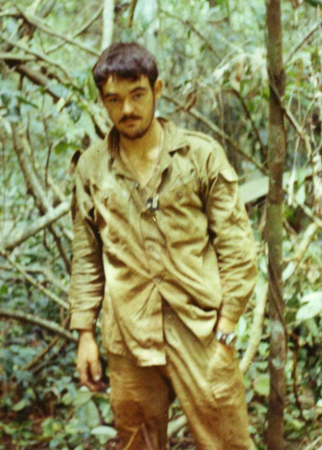
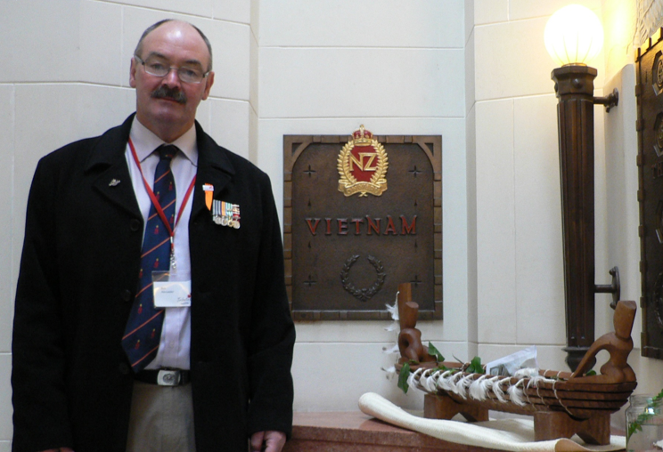
1971
2008
It took 37 years for the toxic effects of Agent Orange on NZ troops to be recognized by the government, for the apology
to be delivered and redress provided. To safely return to society

Slide 3
PROBLEM
Service-related harm can outlast recognition
Repeated exposure can produce cumulative or delayed harm.
Medical, operational and compensation records remain fragmented.
Discharge from service can disrupt monitoring and continuity of care.
Recognition must lead to treatment, redress and whole-of-life support.
2
Notes:
Suggested speaking time: 60 seconds
Service-related harm can unfold over a period much longer than the operation that produced it. Psychological effects may accumulate across incidents. Physical conditions may emerge after a long latency. The authors identify fragmented records, disrupted transitions from military to civilian care, and inconsistent support pathways across services. A person can experience harm before scientific, organisational or compensation systems recognise its significance. The problem is therefore larger than finding a diagnosis or recording an isolated event. It concerns whether the system can preserve an exposure history, connect it with later health outcomes and provide appropriate support. The necessity of military and emergency services strengthens the responsibility to investigate their risks. It cannot justify leaving those risks outside sustained research and care.
Sources:
https://pollution-diseases-ojs.org/index.php/pd/article/view/97
https://pollution-diseases-ojs.org/index.php/pd/article/view/97/66
Article pages: 170–178.
The presentation summarises the authors’ conceptual case analysis and distinguishes reported findings from proposed reforms. Survey percentages describe probable PTSD screening among respondents. Legislative discussion describes the pathways and critiques examined in the October 2026 paper, rather than individual eligibility determinations. The expanded model is a proposal, not an evaluated intervention.

Slide 4
THEORY
Three regimes of scientific recognition
Regime | Central question
Accompanying Science | How can action be technically managed?
Warning Science | Do warning signs justify precaution?
Critical Reconstruction | Why did recognition arrive late?
Ideal types can coexist. They are not a compulsory sequence.
3
Notes:
Suggested speaking time: 70 seconds
Nikolaenko’s original framework distinguishes three ideal-typical regimes. Accompanying Science takes the operational objective as given and asks how the activity can be technically managed. Warning Science asks whether converging signs justify precaution before final causal certainty. Critical Reconstruction investigates why harm became recognisable only late, and how the organisation of knowledge contributed to that delay. The same evidence can have different practical meanings under these regimes. In one setting, uncertainty supports continuation. In another, it triggers monitoring and protection. In reconstruction, uncertainty itself becomes an object of inquiry. These regimes describe orientations rather than a compulsory chronological sequence. They can coexist within an institution. The model makes the decision about uncertainty visible and asks who carries the burden when evidence remains incomplete.
Sources:
https://pollution-diseases-ojs.org/index.php/pd/article/view/97
https://pollution-diseases-ojs.org/index.php/pd/article/view/97/66
https://doi.org/10.66659/bb4q9n88
Article pages: 171–172, 189.
The presentation summarises the authors’ conceptual case analysis and distinguishes reported findings from proposed reforms. Survey percentages describe probable PTSD screening among respondents. Legislative discussion describes the pathways and critiques examined in the October 2026 paper, rather than individual eligibility determinations. The expanded model is a proposal, not an evaluated intervention.

Slide 5
METHOD
A comparative conceptual case analysis
Case 1 examines psychological harm across military and emergency services.
Case 2 examines disease and other physical effects of service.
Evidence includes legislation, official reports and published research.
The study applies and extends a framework. It creates no new dataset.
5
Notes:
Suggested speaking time: 55 seconds
The study uses a comparative conceptual case analysis. The first case examines psychological harm in qualifying military operations, routine military service and emergency services. The second examines physical conditions linked to service and work, including cancers and other gradual process disease. The evidence draws on legislation, operational arrangements, official reports, compensation processes and published research. The authors first use the three-regime framework to identify recognition failures. They then develop the two additional regimes and apply the expanded model to both cases. This is an analytical extension, rather than a new epidemiological study. The paper reports that no new data were created or analysed. Its contribution is a framework for connecting evidence, responsibility and action, whose implementation and effects still require evaluation.
Sources:
https://pollution-diseases-ojs.org/index.php/pd/article/view/97
https://pollution-diseases-ojs.org/index.php/pd/article/view/97/66
Article pages: 170–171, 181–186.
The presentation summarises the authors’ conceptual case analysis and distinguishes reported findings from proposed reforms. Survey percentages describe probable PTSD screening among respondents. Legislative discussion describes the pathways and critiques examined in the October 2026 paper, rather than individual eligibility determinations. The expanded model is a proposal, not an evaluated intervention.

Slide 6
THEORY
The Nikolaenko-Alexander Model
Critical Practice
Critical Regeneration
What must change now?
How must the system change?
Protection, monitoring, redress
and operational change.
Continuing research, connected
records and accountable governance.
Five regimes connect recognition with present action and future redesign.
4
Notes:
Suggested speaking time: 65 seconds
The paper identifies a gap between explaining past failure and organising a response. Critical Reconstruction can establish why evidence remained fragmented, yet that account does not fully specify the steps needed to protect people now. Critical Practice addresses the present consequences through monitoring, redress and operational change. Critical Regeneration redesigns research, governance and occupational practice so that future non-recognition becomes less likely. Together with the original three regimes, these additions form the Nikolaenko-Alexander Model. The distinction matters. Providing support to an affected worker is an immediate responsibility. Building a continuing exposure register is a change to the system that will support many future workers. Both are necessary, and neither can be replaced by publishing a retrospective account of what went wrong.
Sources:
https://pollution-diseases-ojs.org/index.php/pd/article/view/97
https://pollution-diseases-ojs.org/index.php/pd/article/view/97/66
https://doi.org/10.66659/bb4q9n88
Article pages: 179–180, 191–193.
The presentation summarises the authors’ conceptual case analysis and distinguishes reported findings from proposed reforms. Survey percentages describe probable PTSD screening among respondents. Legislative discussion describes the pathways and critiques examined in the October 2026 paper, rather than individual eligibility determinations. The expanded model is a proposal, not an evaluated intervention.

Slide 7
RESULTS / CASE 1
Fragmented records weaken recognition
Service histories and health outcomes do not connect automatically.
Stigma and disrupted transitions can reduce reporting.
Small, separate cohorts limit analysis of shared risks.
Existing data provide a basis for better linkage but is currently siloed across agencies.
6
Notes:
Suggested speaking time: 60 seconds
The first result concerns the organisation of evidence. The paper describes barriers to help seeking, including stigma, and discontinuities when personnel leave service. Separately maintained records can prevent investigators from identifying shared patterns across military, fire, ambulance and police work. The authors cite the 2024 Social Wellbeing Agency work using the Integrated Data Infrastructure to identify the veteran population. That initiative shows that evidence can be assembled from existing administrative sources. It also highlights the importance of defining who is present in a dataset and who is missing. A linked database alone does not establish causation. It provides a basis for analysis that isolated records cannot support. The proposed response is sustained linkage of relevant service and health histories, with continuity through discharge and later life.
Sources:
https://pollution-diseases-ojs.org/index.php/pd/article/view/97
https://pollution-diseases-ojs.org/index.php/pd/article/view/97/66
https://www.sia.govt.nz/publications/Building-in-evidence-base-for-understanding-veteran-outcomes
Article pages: 173–179.
The presentation summarises the authors’ conceptual case analysis and distinguishes reported findings from proposed reforms. Survey percentages describe probable PTSD screening among respondents. Legislative discussion describes the pathways and critiques examined in the October 2026 paper, rather than individual eligibility determinations. The expanded model is a proposal, not an evaluated intervention.

Slide 8
RESULTS / PSYCHOLOGICAL HARM
The warning signal is already measurable
FENZ survey group | Probable PTSD
Uniformed firefighters | 13.4%
Communication centre staff | 30.9%
Screening results among 2023 survey respondents, not clinical diagnoses.
Source: Whanaungatanga Wellbeing Survey, 2023.
7
Notes:
Suggested speaking time: 60 seconds
The 2023 Whanaungatanga Wellbeing Survey provides a concrete warning signal. Among survey respondents, 13.4 percent of uniformed firefighters met criteria for probable PTSD. The corresponding figure for communication centre staff was 30.9 percent. These figures are screening results, rather than confirmed clinical diagnoses, and describe the survey groups rather than every person in the workforce. They show why support design must consider people whose role exposes them to traumatic information, alongside personnel physically at an incident. The report also links perceived organisational support with mental health outcomes, without establishing causation from those associations. For this presentation, the central implication is that measurable distress already warrants a serious response. The model asks how that warning changes monitoring, support and the recognition rules.
Sources:
https://pollution-diseases-ojs.org/index.php/pd/article/view/97
https://pollution-diseases-ojs.org/index.php/pd/article/view/97/66
https://www.fireandemergency.nz/assets/Documents/Research-and-reports/FENZ-T1_Detailed-report-with-appendices_v1-29Jun2023.pdf
Article pages: 175–176.
The presentation summarises the authors’ conceptual case analysis and distinguishes reported findings from proposed reforms. Survey percentages describe probable PTSD screening among respondents. Legislative discussion describes the pathways and critiques examined in the October 2026 paper, rather than individual eligibility determinations. The expanded model is a proposal, not an evaluated intervention.

Slide 9
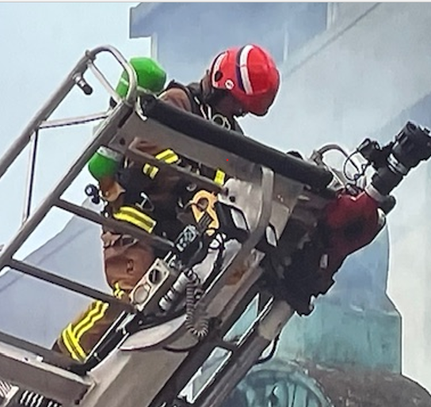
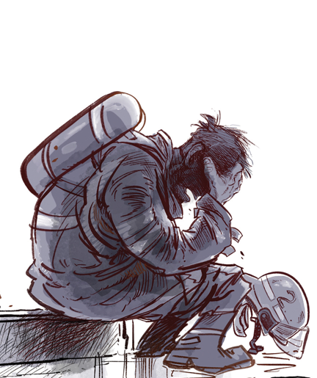
Unlike the body, there is no physical
protection for the psyche, or the soul

Slide 10
RESULTS / LEGAL RECOGNITION
An event-based test can miss cumulative harm
The paper examines ACC section 21B’s event-based mental injury test.
Repeated occupational trauma challenges a single-incident framework.
Remote exposure raises specific barriers for communications staff.
The authors call for recognition rules that reflect service realities.
8
Notes:
Suggested speaking time: 70 seconds
The article examines a mismatch between occupational harm and the legal categories used to recognise it. Its discussion of Accident Compensation Act section 21B focuses on an event-based work-related mental injury pathway, direct exposure requirements and the exclusion of gradual processes from that definition. A series connected to one incident is different from cumulative exposure across a career. Communication personnel present a further difficulty when the traumatic event reaches them by telephone or radio. The authors argue that recognition should reflect the realities of the work, rather than impose an event structure that omits relevant patterns of harm. This is the paper’s legal and policy critique of a particular pathway. It should not be read as a statement that every affected person lacks all support or that all ACC claims must fail.
Sources:
https://pollution-diseases-ojs.org/index.php/pd/article/view/97
https://pollution-diseases-ojs.org/index.php/pd/article/view/97/66
Article pages: 175–178.
The presentation summarises the authors’ conceptual case analysis and distinguishes reported findings from proposed reforms. Survey percentages describe probable PTSD screening among respondents. Legislative discussion describes the pathways and critiques examined in the October 2026 paper, rather than individual eligibility determinations. The expanded model is a proposal, not an evaluated intervention.

Slide 11
RESULTS / EQUITY
Similar duties can lead to different support pathways
Pathway examined | Recognition issue
Qualifying military service | Defined conditions can use service-specific presumptions
Routine and emergency service | Individual work-related causation tests
Volunteer service | Have no similar protections in law because they are not employed
Comparable risks deserve an explicit review of equitable protection.
9
Notes:
Suggested speaking time: 60 seconds
The paper contrasts qualifying operational military service with routine military and emergency service pathways. Veterans’ support includes service-specific presumptions for defined conditions and deployments. Current Veterans’ Affairs guidance confirms that automatic acceptance depends on the condition and the time and place of qualifying service. The authors contrast this approach with individual causation requirements discussed under ACC for gradual process disease. They also identify employment status as an obstacle in the work-related pathways examined for volunteers. That is a specific coverage concern, rather than a claim that volunteers have no access to any ACC benefit. The broader question is whether comparable risks and duties receive equitable protection. The proposed answer is to examine the substance of exposure and responsibility alongside the administrative category through which a person enters the system.
Sources:
https://pollution-diseases-ojs.org/index.php/pd/article/view/97
https://pollution-diseases-ojs.org/index.php/pd/article/view/97/66
https://www.veteransaffairs.mil.nz/for-clients/how-we-make-decisions/conditions-we-cover/presumptiveconditions/
Article pages: 176–177, 181–183.
The presentation summarises the authors’ conceptual case analysis and distinguishes reported findings from proposed reforms. Survey percentages describe probable PTSD screening among respondents. Legislative discussion describes the pathways and critiques examined in the October 2026 paper, rather than individual eligibility determinations. The expanded model is a proposal, not an evaluated intervention.

Slide 12
RESULTS / CASE 2
Physical illness requires a history of exposure
Long latency can separate illness from the service that preceded it.
Cumulative toxic exposure requires more than incident counts.
Presumptive pathways already exist but only for defined veteran conditions.
The authors propose stronger occupational recognition and monitoring.
10
Notes:
Suggested speaking time: 65 seconds
The second case applies the expanded model to physical illness. Long latency can separate a cancer or other chronic condition from the service environment in which relevant exposure occurred. Simple incident counts cannot reconstruct the substances encountered, duration of exposure or changing biological effects. The paper argues for continuing research and exposure records that connect operational history with later health. It discusses existing presumptive veteran pathways as evidence that compensation systems can recognise defined service-related conditions without requiring every individual to reconstruct the same causal history. Such rules depend on evidence and specified eligibility. The proposal is to examine how occupational recognition could better reflect military and emergency service risks. A scientific assessment of population-level risk, an individual diagnosis and a legal entitlement remain distinct questions.
Sources:
https://pollution-diseases-ojs.org/index.php/pd/article/view/97
https://pollution-diseases-ojs.org/index.php/pd/article/view/97/66
Article pages: 181–184, 194–195.
The presentation summarises the authors’ conceptual case analysis and distinguishes reported findings from proposed reforms. Survey percentages describe probable PTSD screening among respondents. Legislative discussion describes the pathways and critiques examined in the October 2026 paper, rather than individual eligibility determinations. The expanded model is a proposal, not an evaluated intervention.

Slide 13
RESULTS / CRITICAL PRACTICE
Critical Practice addresses the harm now
Preserve and connect existing exposure and health records.
Maintain care and support through discharge or retirement.
Provide accessible assessment, rehabilitation and redress pathways.
Revise operational practice to reduce continuing exposure.
11
Notes:
Suggested speaking time: 65 seconds
Critical Practice turns recognition into immediate responsibilities. Relevant records need to be preserved and connected before further evidence disappears. Transitions between employers, services and health providers need to maintain continuity of care. Assessment, rehabilitation and redress should be accessible to people who may already face illness, distress and a difficult administrative burden. Ongoing operations should incorporate what the evidence now shows about exposure and harm. These measures do not require every uncertainty to be resolved before any protective action begins. The authors argue that residual uncertainty can trigger monitoring and practical protection. The specific action must still match the evidence and the context. The central change is assigning responsibility to organisations and government to act on recognised risk, rather than treating the claimant’s incomplete historical record as the end of the inquiry.
Sources:
https://pollution-diseases-ojs.org/index.php/pd/article/view/97
https://pollution-diseases-ojs.org/index.php/pd/article/view/97/66
Article pages: 179–180, 191–193.
The presentation summarises the authors’ conceptual case analysis and distinguishes reported findings from proposed reforms. Survey percentages describe probable PTSD screening among respondents. Legislative discussion describes the pathways and critiques examined in the October 2026 paper, rather than individual eligibility determinations. The expanded model is a proposal, not an evaluated intervention.

Slide 14
RESULTS / CRITICAL REGENERATION
Critical Regeneration changes the system
Standing research programmes connect services and disciplines.
Exposure registers preserve evidence across a working lifetime.
Independent review and escalation make warning signs actionable.
Governance incorporates worker voice and support for families.
12
Notes:
Suggested speaking time: 65 seconds
Critical Regeneration addresses the conditions that produce recurring non-recognition. The authors propose standing research programmes, exposure registers, independent review and escalation pathways. Research should span the relevant services and disciplines rather than depend on an isolated study after each controversy. Records should follow a person across service, discharge and later life. Governance should specify who reviews a warning, who must respond and how that response remains accountable. Worker voice and the needs of families belong within the design. These are proposals for a continuing recognition-to-action system. They require funding, appropriate data safeguards, implementation and evaluation. The intended outcome is earlier recognition and intervention. The paper establishes the conceptual argument for that design, rather than demonstrating that the proposed system has already produced those outcomes.
Sources:
https://pollution-diseases-ojs.org/index.php/pd/article/view/97
https://pollution-diseases-ojs.org/index.php/pd/article/view/97/66
Article pages: 180, 185–186, 191–193.
The presentation summarises the authors’ conceptual case analysis and distinguishes reported findings from proposed reforms. Survey percentages describe probable PTSD screening among respondents. Legislative discussion describes the pathways and critiques examined in the October 2026 paper, rather than individual eligibility determinations. The expanded model is a proposal, not an evaluated intervention.

Slide 15
KEY TAKEAWAYS
Recognition must produce action
Fragmented evidence can conceal a continuing process of harm.
Critical Practice addresses present consequences.
Critical Regeneration prevents the repetition of recognition failures.
Equitable support requires connected science, governance and practice.
13
Notes:
Suggested speaking time: 60 seconds
Four conclusions bring the argument together. Fragmented evidence can conceal a continuing process of harm even when individual records are accurate. Critical Practice makes present consequences a matter of action: support, monitoring, redress and changes to operations. Critical Regeneration makes future recognition a design responsibility through continuing research and accountable governance. Equitable support depends on connecting those functions across services, rather than leaving people to navigate separate systems after their health has deteriorated. The model’s wider international applicability is a proposition for further study. Different operational settings and laws need their own analysis. The shared principle is clear: a response to occupational and service-related harm is incomplete when it explains a failure but leaves the conditions that produced it intact.
Sources:
https://pollution-diseases-ojs.org/index.php/pd/article/view/97
https://pollution-diseases-ojs.org/index.php/pd/article/view/97/66
Article pages: 185–186.
The presentation summarises the authors’ conceptual case analysis and distinguishes reported findings from proposed reforms. Survey percentages describe probable PTSD screening among respondents. Legislative discussion describes the pathways and critiques examined in the October 2026 paper, rather than individual eligibility determinations. The expanded model is a proposal, not an evaluated intervention.

Slide 16

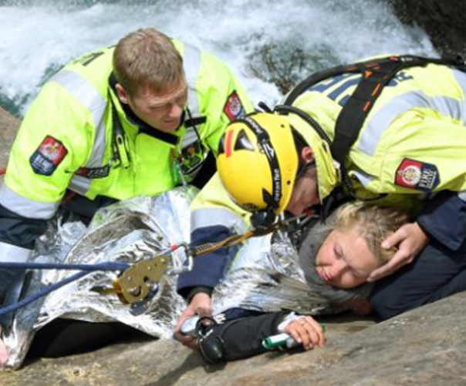
We need our heroes
Mā te mahi tahi o tēnei rā
ka tata mai te tāhapatū o te rangi
mō ngā pāraeroa o āpōpō me ō rātou whānau
Our collective effort today
brings the horizon closer
for tomorrow’s veterans and their families

Slide 17
REFERENCES
Key references
Alexander, R., & Mann, S. (2026). Equitable and Consistent Support.
Pollution and Diseases 2: 168–198. doi: 10.66659/8vjw4853
Nikolaenko, D. (2026). Military Contamination and Regimes of
Scientific Recognition. doi: 10.66659/bb4q9n88
Fire and Emergency NZ / AUT (2023). Whanaungatanga Wellbeing
Survey: Detailed Report.
Barr, M., & Young, D. (2024). Building an Evidence Base for
Understanding Veteran Outcomes. Social Wellbeing Agency.
Veterans’ Affairs NZ. Conclusively Presumed Conditions.
Official guidance updated 21 April 2026.
14
Notes:
Suggested speaking time: 50 seconds
These references identify the foundations of the presentation. Alexander and Mann provide the conceptual extension and the New Zealand case analysis. Nikolaenko provides the original three regimes. The FENZ survey supplies the psychological screening results discussed here. The 2024 veteran data report provides an example of assembling an evidence base from administrative records. Veterans’ Affairs guidance explains defined presumptive conditions and their eligibility context. The full publication contains the broader bibliography and the comparative tables. The QR code on the closing slide links to that record. The distinction between reported findings, the authors’ interpretation and proposals for future implementation remains important when carrying this framework into another country, service or legal system.
Sources:
https://pollution-diseases-ojs.org/index.php/pd/article/view/97
https://pollution-diseases-ojs.org/index.php/pd/article/view/97/66
Article pages: 196–198.
The presentation summarises the authors’ conceptual case analysis and distinguishes reported findings from proposed reforms. Survey percentages describe probable PTSD screening among respondents. Legislative discussion describes the pathways and critiques examined in the October 2026 paper, rather than individual eligibility determinations. The expanded model is a proposal, not an evaluated intervention.

Slide 18

DISCUSSION
A continuing system of recognition and support
Rex Alexander and Samuel Mann
Otago Polytechnic NZ
Capable, College of Work Based Learning
rex.alexander@envirocom.co.nz
Recognition must lead to support
and changes in the conditions of service.
Full paper and references
doi: 10.66659/8vjw4853
15
Notes:
Suggested speaking time: 50 seconds
We conclude with the practical question that motivated the paper: what must change so that service-related harm becomes recognisable and actionable before a person has spent years seeking support? The Nikolaenko-Alexander Model connects technical management and warning with reconstruction, present action and future redesign. It asks institutions to preserve evidence, acknowledge responsibility and organise support across a lifetime. Families remain part of that responsibility. The next step is to evaluate how the proposed regimes can operate in real services, with clear responsibilities and measurable outcomes. The purpose is earlier and more consistent protection for those who serve. The publication and its full reference list are available through the QR code, and the corresponding author’s contact is shown here.
Sources:
https://pollution-diseases-ojs.org/index.php/pd/article/view/97
https://pollution-diseases-ojs.org/index.php/pd/article/view/97/66
Article pages: 185–186.
The presentation summarises the authors’ conceptual case analysis and distinguishes reported findings from proposed reforms. Survey percentages describe probable PTSD screening among respondents. Legislative discussion describes the pathways and critiques examined in the October 2026 paper, rather than individual eligibility determinations. The expanded model is a proposal, not an evaluated intervention.

