Slide 1
THEMATIC OVERVIEW / P&D CONFERENCE / 17 OCTOBER 2026
War-Affected Soil and the
Organisation of Scientific Inquiry
Thematic overview of twelve contributions
From scientific weaknesses to new research organisation
and the right to empirical testing
Dmitry Nikolaenko
Editor-in-Chief, Pollution and Diseases
11:20–11:40 / 20 minutes
1
Notes:
Slide 1 / 00:00–00:30 / 30 seconds
This overview presents twelve contributions as one developing argument. We begin with an unexpected gap in conference preparation and examine weaknesses in contemporary scientific practice. We then present a new organisation of research, illustrate the objects it should investigate, and conclude with the conditions for testing new theories. Each contribution retains its own question. Their order explains why the practical research programme is necessary.
Source record
Synthesis of the twelve supplied contributions.

Slide 2
THE LOGIC OF THE TWELVE CONTRIBUTIONS
From an unexpected absence
to a programme of empirical inquiry
1 The unexpected absence of direct soil contributions
2–6 Weaknesses and implicit standards of scientific practice
7–9 New research organisation and regimes of recognition
10–11 New pollution and a new understanding of soil
12 Timely conditions for empirical testing
2
Notes:
Slide 2 / 00:30–01:30 / 60 seconds
The starting point is practical. The conference contains many contributions, and these twelve papers receive one collective overview. Their sequence follows the development of our research question.
Paper one records the initial surprise. Papers two to six examine scientific weaknesses: certification without adequate checking, selective disciplinary memory, inherited state dependence, fragmentation and political taboo. Papers seven to nine propose organisation and operations that can support continuing inquiry and practical response. Papers ten and eleven show substantive changes in what we recognise as an object. Paper twelve asks how those propositions obtain a fair empirical test.
This sequence connects criticism with research design. We speak openly about the scientific community because its decisions shape what can be known about dangerous environmental processes. We also specify an alternative and accept the obligation to test it.
Source record
Synthesis of the twelve supplied contributions.

Slide 3
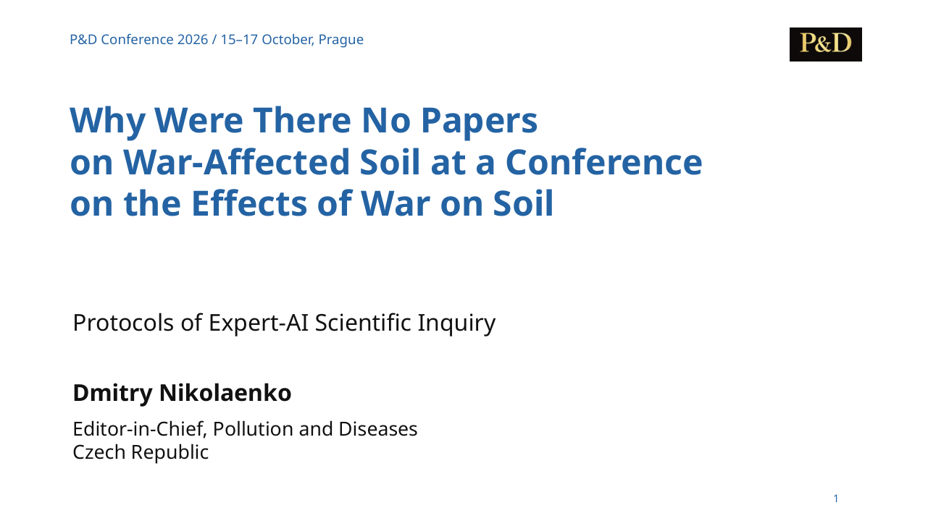
CONTRIBUTION 01 / THE INITIAL SURPRISE
Why Were There No Papers on War-Affected Soil at a Conference on the Effects of War on Soil. Protocols of Expert-AI Scientific Inquiry.
Dmitry Nikolaenko
MAIN IDEA
The missing soil contributions make scientific attention itself a research question.
Conference preparation exposed the gap.
The institutional explanation needs its own tests.
Original presentation title page
3
Notes:
Slide 3 / 01:30–02:55 / 85 seconds
The first paper begins with an unexpected organising experience. The conference originally focused on the effects of war on soil and freshwater. Hundreds of invitations, including approaches to published specialists, produced virtually no independent proposals centred directly on affected soil. Expanding the programme made the conference richer, but it also made the original absence more visible.
This observation opens the series. It does not establish that nobody studies war-affected soil anywhere. It asks why the proposed object failed to become a shared question in this particular setting. The expert–AI protocol develops a distinction between readiness to participate in an accepted project and readiness to examine the foundations of that project. An organisation can possess technical expertise while remaining reluctant to reconsider what it studies.
The organising experience therefore becomes a metascientific question. Which questions receive attention, which remain outside stable programmes, and what evidence would explain the difference? Outreach records and project decisions could test the proposed institutional explanation. Our surprise becomes the reason to examine the scientific community itself.
Source record
Why_No_Papers_on_War_Affected_Soil_15min_EN_v2(2).pptx
Supplied presentation, title page and main argument.

Slide 4
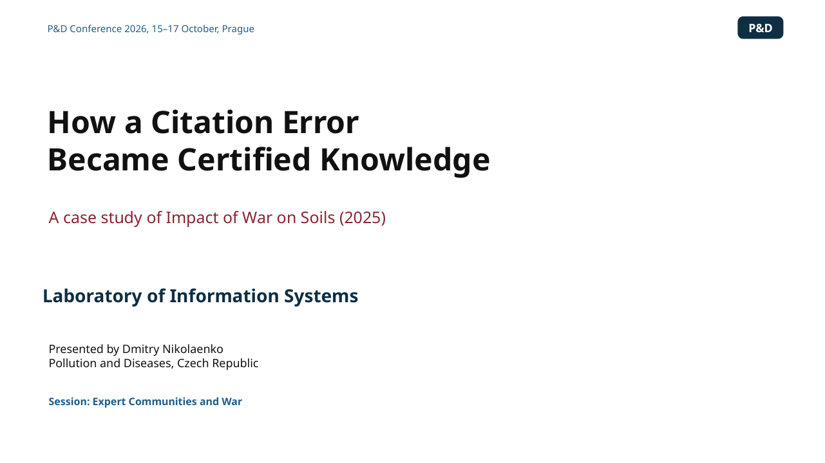
CONTRIBUTION 02 / WEAKNESSES OF SCIENTIFIC PRACTICE
How a Citation Error Became Certified Knowledge.
Laboratory of Information Systems
MAIN IDEA
A reproducible number acquired authority while measuring the wrong object.
121,406 km² describes a military property portfolio.
It cannot establish the global area of war-damaged soil.
Original presentation title page
4
Notes:
Slide 4 / 02:55–04:20 / 85 seconds
The second paper moves from an absence to a concrete published failure. A review entitled Impact of War on Soils gives 121,406 square kilometres as territory affected by wars. Its reference fifty-nine leads to an article about the land portfolio of the United States military. Converting nearly thirty million acres into square kilometres reproduces the published number. The arithmetic works. The cited source measures military property, including uses that do not establish damage to soil.
This is an elementary category error with consequences for the review’s opening account of the global problem. The audit also examines the denominator, the treatment of soil and the imbalance of the bibliography. Here the criticism concerns inspectable claims and sources.
The larger question is how the statement passed through authorship, review, editing, publication and subsequent recommendation. Every stage can rely on the authority of another stage until nobody checks the substantive connection. Publication then certifies an unsupported claim. Scientific responsibility requires an answer to the documented mismatch and a correction that remains visible wherever the claim circulates.
Source record
How_a_Citation_Error_Became_Certified_Knowledge_Final_EN_v2(3).pptx
Supplied presentation, title page and main argument.

Slide 5
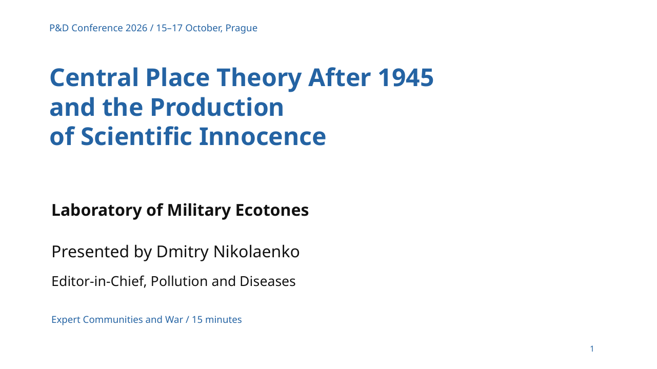
CONTRIBUTION 03 / WEAKNESSES OF SCIENTIFIC PRACTICE
Central Place Theory After 1945 and the Production of Scientific Innocence.
Laboratory of Military Ecotones
MAIN IDEA
Post-war canon formation made Christaller’s Nazi planning work dispensable to the theory’s history.
The chronology separates the 1932–1933 theory from wartime planning.
Scientific innocence is the paper’s critical interpretation.
Original presentation title page
5
Notes:
Slide 5 / 04:20–05:45 / 85 seconds
The third paper examines the historical account through which a discipline recognises its own achievements. Central place theory often appears as an elegant spatial model. The presentation restores Christaller’s planning work for conquered Eastern territories under the Nazi regime and asks why that work became optional in later accounts of the theory.
Chronology matters. Christaller completed his dissertation in 1932 and published the book in 1933. His wartime planning followed. We should preserve those distinctions while examining how the model entered a political project involving territory and populations. The criticism concerns the later separation of scientific form from the institutions and purposes that used it.
The paper calls that reconstruction the production of scientific innocence. A disciplinary classic can retain its authority while its politically consequential history disappears from normal teaching and discussion. This mechanism matters beyond one theory. If an expert community treats its involvement in violence as external to its scientific history, it weakens its capacity to investigate the environmental consequences of violence. Open historical examination belongs within scientific responsibility.
Source record
Central_Place_Theory_PD_Conference_2026_Final_EN_v3(4).pptx
Supplied presentation, title page and main argument.

Slide 6
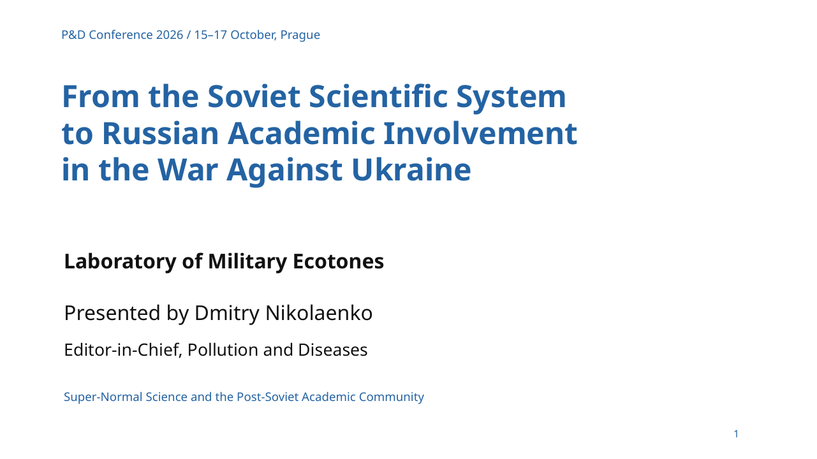
CONTRIBUTION 04 / WEAKNESSES OF SCIENTIFIC PRACTICE
From the Formation of the Soviet Scientific System to the Involvement of Russian Academic Organizations in the War Against Ukraine.
Laboratory of Military Ecotones
MAIN IDEA
The paper connects academic legitimation of war with a reproduced dependence on state authority.
Soviet institutional inheritance enters the explanation.
“Super-normal science” is a mechanism proposed for testing.
Original presentation title page
6
Notes:
Slide 6 / 05:45–07:10 / 85 seconds
The fourth paper brings institutional history into the present war against Ukraine. Its central question concerns how academic organisations can retain their professional forms while repeatedly adapting their account of reality to state demands. Degrees, journals and councils continue. The framework of acceptable explanation changes with political authority.
The proposed concept of super-normal science describes that dependence. The paper traces its formative conditions to the Soviet system and examines negative selection against autonomous problem formulation. Ignoring this totalitarian inheritance makes contemporary academic involvement appear disconnected from the institutions that prepared it.
The presentation uses dated institutional cases. They include changes in academic status in Crimea, the governing structure of the Russian Geographical Society, and the Russian Union of Rectors’ public support for the state’s account of the invasion in March 2022. These records establish specific roles and statements. The wider mechanism requires comparative testing.
The implication for our subject is direct. An academic system that learns to legitimate state priorities can also shape which consequences of war become investigable. Autonomous inquiry into inconvenient harm therefore has an institutional history that we must examine openly.
Source record
Soviet_Scientific_System_PD_Conference_2026_Final_EN(1).pptx
Supplied presentation, title page and main argument.

Slide 7
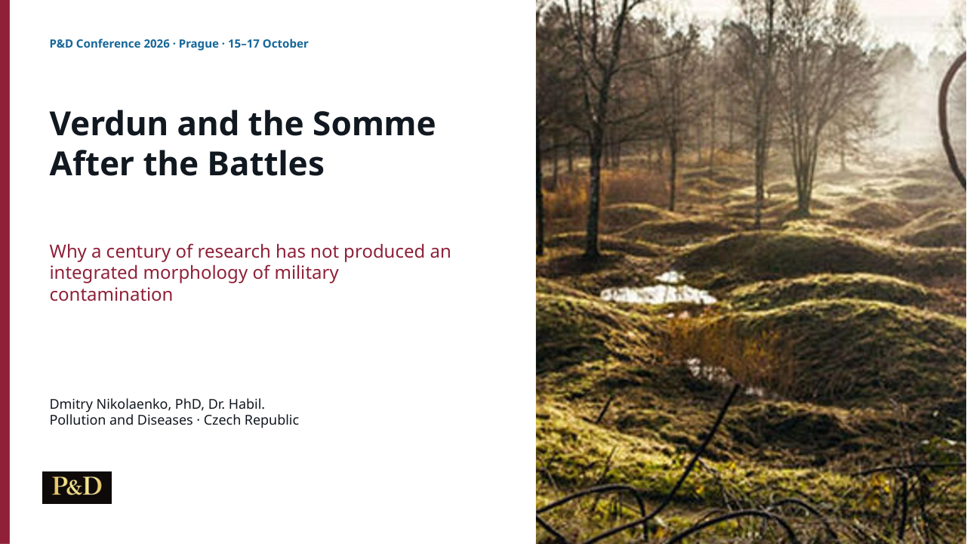
CONTRIBUTION 05 / WEAKNESSES OF SCIENTIFIC PRACTICE
Verdun and the Somme After the Battles: Fragmented Expertise and the Morphology of Long Term Military Contamination.
Dmitry Nikolaenko
MAIN IDEA
A century of specialist research can leave the continuing contamination process fragmented.
Battle chronology and material duration have different endings.
Post-war management changes the morphology of contamination.
Original presentation title page
7
Notes:
Slide 7 / 07:10–08:35 / 85 seconds
The fifth paper examines Verdun and the Somme after more than a century of research. Military historians reconstruct events. Archaeology and geophysics recover buried objects. Soil science, geomorphology and toxicology investigate environmental processes. Heritage management and clearance define further objects of expertise. The paper recognises this accumulated knowledge and asks why the complete process remains weakly integrated.
The material duration of warfare extends beyond the duration of the battles. Corrosion transforms objects. Water and soil movement redistribute material. Clearance can remove hazards from one place and concentrate them elsewhere. Forestry, cultivation and later construction change the conditions under which people encounter the residue.
The weakness concerns the connections between expert objects. More precise fragments do not automatically reconstruct those transitions. Even a long research history cannot repair an architecture that leaves their relationships without an owner.
The proposed morphology preserves the connection between the military event, residual material, subsequent interventions and later exposure. This historical example gives the series a practical warning: time alone will not produce an integrated account of long-term military contamination. Someone must organise the causal reconstruction.
Source record
Verdun_Somme_Presentation(2).pptx
Supplied presentation, title page and main argument.

Slide 8
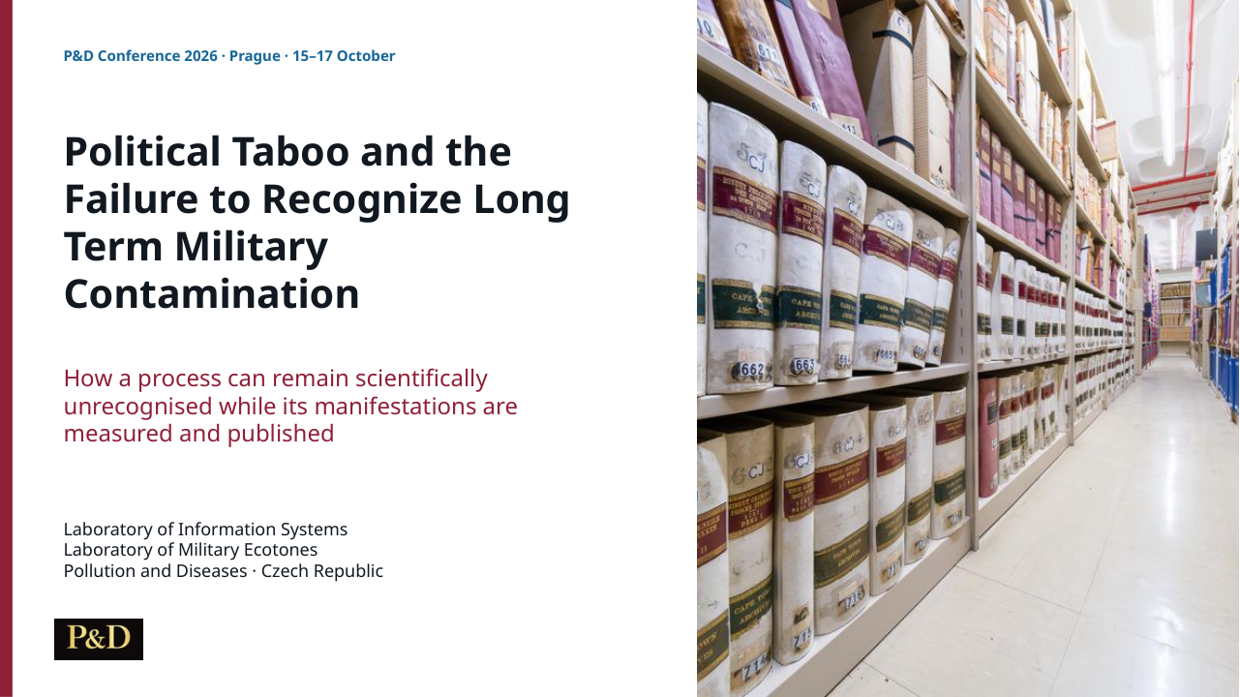
CONTRIBUTION 06 / WEAKNESSES OF SCIENTIFIC PRACTICE
Political Taboo and the Failure to Recognize Long Term Military Contamination.
Laboratory of Information Systems
MAIN IDEA
Political taboo can regulate admissible questions while measurements and publications continue.
Questions, time horizons and causal links receive unequal legitimacy.
Unconnected observations can conceal a continuing process.
Original presentation title page
8
Notes:
Slide 8 / 08:35–10:00 / 85 seconds
The sixth paper draws the preceding criticisms into an account of scientific admissibility. Political taboo need not take the form of a written prohibition. It can operate through practical decisions about legitimate questions, acceptable time horizons, admissible causal connections and the evidence demanded from different explanations.
Researchers may measure manifestations of a process while the process itself remains outside a shared programme. Questions can be postponed, divided between disciplines, renamed or restricted to a convenient location. The paper calls attention to observations that have neither been refuted nor allowed to become a common problem.
We need to speak openly about this organisation of inquiry. Accepting political taboo as a normal professional constraint can prevent recognition of long-term military contamination. At the same time, a particular allegation of obstruction requires records of decisions and their effects.
The scientific community therefore enters the object of investigation. It produces measurements, participates in military and administrative systems, and determines which records remain available for later reconstruction. Its responsibility includes preserving the possibility of stronger evidence. This completes the diagnostic part of the overview and prepares the constructive response.
Source record
Political_Taboo_Conference_Presentation_v2(2).pptx
Supplied presentation, title page and main argument.

Slide 9
CONTRIBUTION 07 / NEW ORGANISATION OF RESEARCH
Building Research Infrastructure for Long-Term Studies of War: Project-Based Laboratories for Field Research, Information Systems, and Decision Support.
Laboratory of Information Systems
MAIN IDEA
P&D Conference 2026 / 15–17 October, Prague
Permanent laboratories preserve inquiry across the changing life of individual projects.
Building Research Infrastructure for Long-Term Studies of War: Project-Based Laboratories for Field Research, Information Systems, and Decision Support.
Field research and information systems have distinct responsibilities.
Laboratory of Information Systems
Projects leave records that a later team can examine and reuse.
Title block from the supplied speaker manuscript
9
Notes:
Slide 9 / 10:00–11:25 / 85 seconds
The seventh contribution begins the constructive part. We propose an organisation that can retain a developing research question when particular projects and their funding end. The framework distinguishes permanent laboratory capacity from temporary project teams. Each project has a defined question, participants, budget and responsibilities. The laboratory retains its substantive mission and research memory.
Two laboratories perform different functions within a common organisational framework. The Laboratory of Military Ecotones investigates territories transformed by war and military activity. The Laboratory of Information Systems preserves and interprets the complex information needed to connect observations across projects. Both belong within New Euro Vision in the Czech Republic.
Their continuing responsibility extends beyond retaining a final report. Later work needs source records, methodological decisions, usable data and an account of unresolved relations. Field observations must be able to change the information model, and information analysis must guide further field inquiry.
This is our practical response to fragmentation. The structure makes continuity and verification identifiable tasks. Its performance requires examination through actual projects and their retained records. We apply the same evidential expectations to our own organisation that we apply to established institutions.
Source record
Building_Research_Infrastructure_15min_Speaker_Text_EN(2).docx
Supplied speaker manuscript, title and main argument.
The title panel is reconstructed from the supplied speaker manuscript. No original presentation cover was supplied for this contribution.

Slide 10
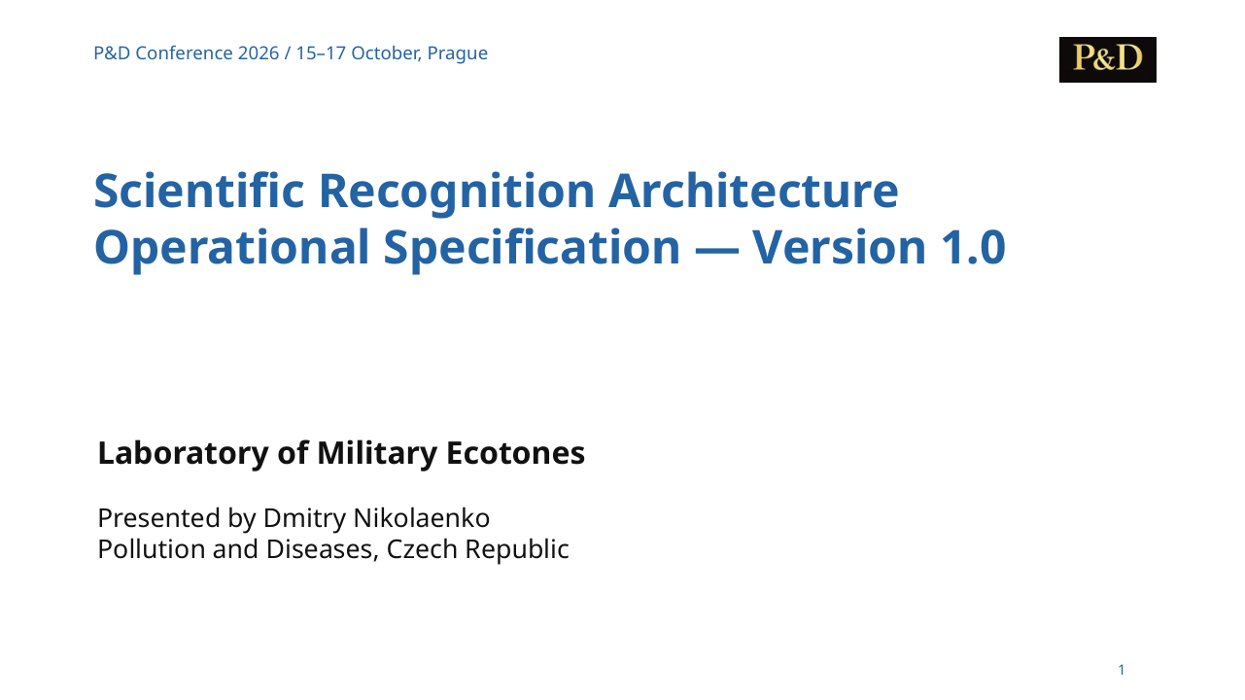
CONTRIBUTION 08 / NEW ORGANISATION OF RESEARCH
Scientific Recognition Architecture: Operational Specification — Version 1.0.
Laboratory of Military Ecotones
MAIN IDEA
The specification organises continued recognition of a developing object under uncertainty.
Observations retain provenance, relationships and unresolved questions.
Empirical correspondence governs revision of explanations.
Original presentation title page
10
Notes:
Slide 10 / 11:25–12:50 / 85 seconds
The eighth paper gives the organisational proposal an operational form. Scientific Recognition Architecture, version one, specifies how researchers can progressively make a developing empirical object scientifically recognisable. The object may change before a satisfactory explanation exists. Research therefore needs operations that preserve observations and relationships while uncertainty remains.
The specification gives the empirical object priority in setting research boundaries. Specialised disciplinary work enters a common investigation. Source records retain their available spatial and temporal context. Inferred causality remains distinguishable from empirical association. Contradictions and changes of direction enter the research record.
Participants can disagree about explanations while accepting a common architecture of inquiry. Version control makes changes in the procedure visible. Review asks whether a difficulty reflects implementation, contradiction or insufficient evidence. Following the specification does not establish the truth of a theory.
The document applies this approach to military ecotones, soil after war and expert–AI work. Its contribution is an explicit procedure for continuing inquiry when familiar classifications leave the object incomplete. The next requirement is operational use and empirical examination of whether the architecture improves recognition and explanation.
Source record
Scientific_Recognition_Architecture_15min_EN(1).pptx
Supplied presentation, title page and main argument.

Slide 11
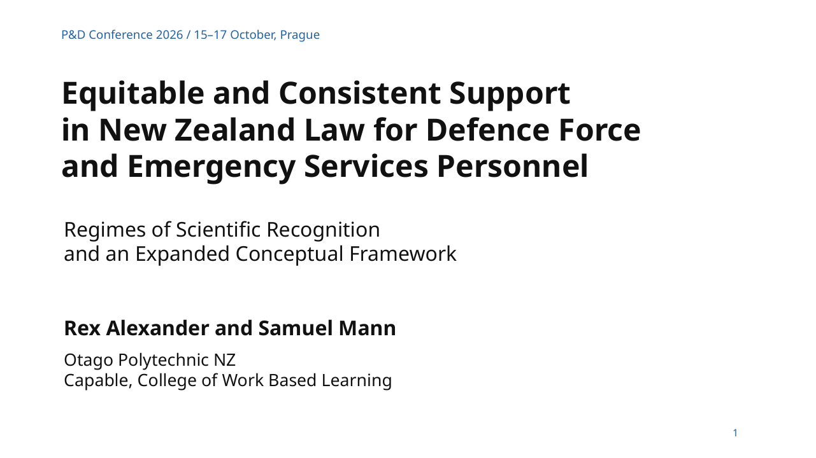
CONTRIBUTION 09 / NEW ORGANISATION OF RESEARCH
From Scientific Recognition to Critical Practice. Support for Military and Emergency Services Personnel in New Zealand.
Rex Alexander and Samuel Mann
MAIN IDEA
Recognition must lead to support now and to changes that prevent repeated failures.
Critical Practice addresses current consequences of service-related harm.
Critical Regeneration connects records, continuing research and governance.
Original presentation title page
11
Notes:
Slide 11 / 12:50–14:15 / 85 seconds
The ninth contribution develops the recognition framework through a different practical field. Rex Alexander and Samuel Mann examine support for military and emergency services personnel in New Zealand. The original presentation carries the fuller title Equitable and Consistent Support in New Zealand Law for Defence Force and Emergency Services Personnel. The programme title highlights its connection with our series.
Their question concerns harm that can outlast both service and institutional recognition. Exposure histories, health outcomes and compensation records remain divided between organisations. Discharge can interrupt monitoring and care. Recognition needs consequences for the affected person.
The authors extend the framework through Critical Practice and Critical Regeneration. Critical Practice asks what must change now in protection, treatment and redress. Critical Regeneration asks how the system should change through continuing research, connected records and accountable governance. These regimes can coexist.
The contribution uses comparative conceptual case analysis rather than a new dataset. It demonstrates development of the original idea: scientific recognition acquires practical and organisational responsibilities. The framework reaches beyond describing an environmental object to examining how institutions respond to people living with long-term consequences.
Source record
Alexander_Mann_Equitable_Support_15min(3).pptx
Supplied presentation, title page and main argument.
Programme title differs from the attached deck title. The overview retains both explicitly.

Slide 12
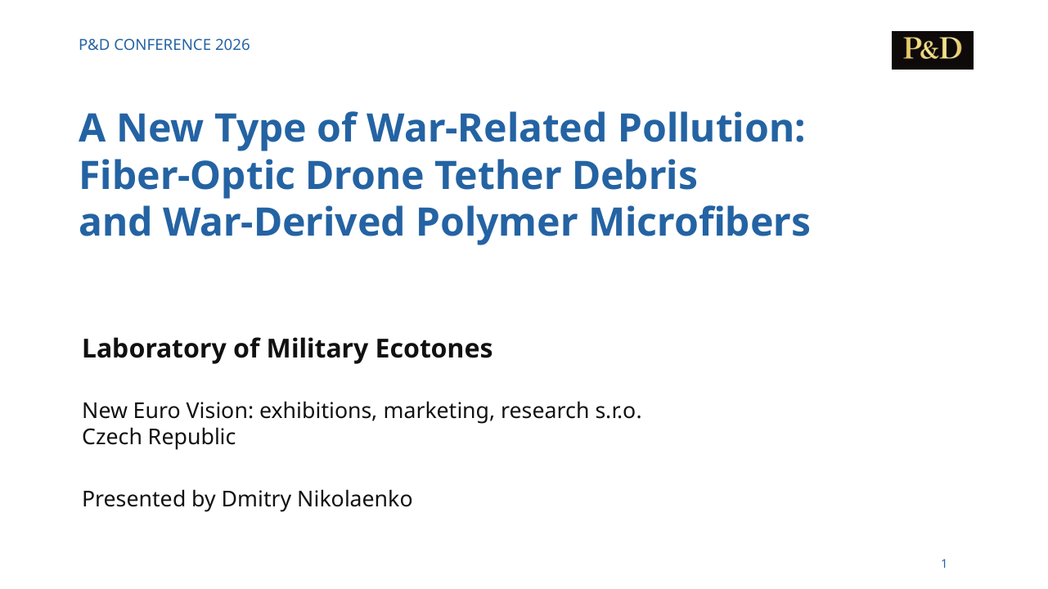
CONTRIBUTION 10 / NEW OBJECTS AND A NEW APPROACH
A New Type of War-Related Pollution: Fiber-Optic Drone Tether Debris and War-Derived Polymer Microfibers.
Laboratory of Military Ecotones
MAIN IDEA
Drone tether residue requires a source-specific account of filament networks and their transformation.
Length, geometry and material identity enter the assessment.
Polymer microfiber formation and effects require field tests.
Original presentation title page
12
Notes:
Slide 12 / 14:15–15:40 / 85 seconds
The tenth paper shows what the proposed approach can make visible. Fibre-optic drone operations leave long residual strands across vegetation and the ground. This material has a particular military source and a diffuse filamentous geometry. Assessing it requires measurements of length, diameter, continuity and contact with the landscape alongside mass and composition.
The paper proposes fibre-optic drone tether debris and war-derived polymer microfibers as source and transformation categories. Material identity matters. Optical components and their polymer coatings have different properties. Weathering may connect visible lines with smaller products, but the transformation rates and environmental consequences require measurements.
Photographs establish a visible form of residue. They cannot establish landscape-wide quantities or all the proposed biological effects. A field programme would connect mapped deposits with material analysis, soil and sediment observations, and repeat visits. Attribution must also distinguish the new deposit from older civilian plastics.
This is a substantive novelty in the series. A changed military technology produces an object that familiar inventories may inadequately describe. Scientific recognition begins by defining that object and specifying the evidence needed to examine its developing consequences.
Source record
Fiber_Optic_Drone_Debris_15min_EN(2).pptx
Supplied presentation, title page and main argument.

Slide 13
CONTRIBUTION 11 / NEW OBJECTS AND A NEW APPROACH
Soil After War As a Configurational Object of the Military Ecotone.
Laboratory of Military Ecotones
MAIN IDEA
P&D Conference 2026 / 15–17 October, Prague
Soil after war is a historically formed, changing configuration within a military ecotone.
Soil After War As a Configurational Object of the Military Ecotone.
Addition, destruction, cessation and reorganisation can interact.
Laboratory of Military Ecotones
Soil carries, transforms and transfers the material consequences.
Title block from the supplied speaker manuscript
13
Notes:
Slide 13 / 15:40–17:05 / 85 seconds
The eleventh paper proposes a new understanding of soil after war. War changes the regime in which a territory functions. Soil enters that regime through altered impacts, relations and subsequent development. The resulting object has a history and continues to change.
The protocol calls it a configurational object. Its condition depends on the combination and sequence of transformations. Addition introduces material or energy. Destruction changes structures and processes. Cessation ends earlier activities, such as cultivation or drainage maintenance. Reorganisation changes use and access. These transformations can occur together.
This definition allows a war-induced soil transformation to begin without the detection of a new chemical pollutant. An abandoned agricultural territory illustrates the question: cessation of management can change water relations, vegetation and soil development. That example remains a proposition for testing.
Soil also acts as a carrier, archive and active medium. It retains traces, transforms substances and participates in transfer to other media. Pre-war history and repeated observations become part of causal attribution. Research polygons, local repeatable sites and experiments give this theory empirical form. The contribution changes the object that the research organisation must be able to follow.
Source record
Soil_After_War_Configurational_Object_15min_Speaker_Text_EN(1).docx
Supplied speaker manuscript, title and main argument.
The title panel is reconstructed from the supplied speaker manuscript. No original presentation cover was supplied for this contribution.

Slide 14
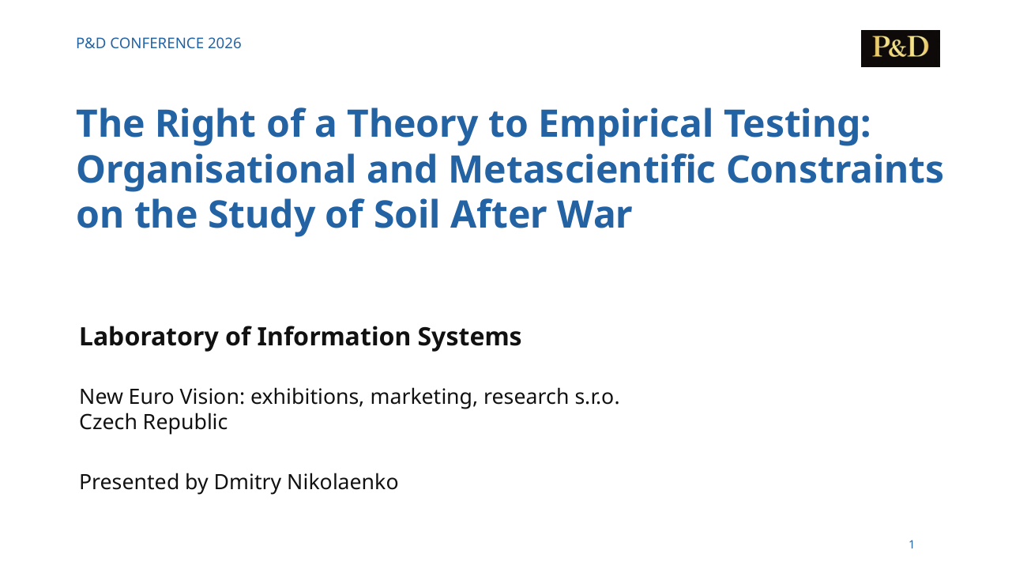
CONTRIBUTION 12 / THE RIGHT TO EMPIRICAL TESTING
The Right of a Theory to Empirical Testing: Organisational and Metascientific Constraints on the Study of Soil After War.
Laboratory of Information Systems
MAIN IDEA
A new theory needs material conditions for an independent and timely empirical test.
Its question must survive sampling design, budgets and access decisions.
Negative findings and revision belong within that right.
Original presentation title page
14
Notes:
Slide 14 / 17:05–18:30 / 85 seconds
The twelfth contribution concludes the series with the conditions under which a new approach can develop. A theory needs more than formal permission to appear in a publication. Testing requires access to sites and records, an appropriate sampling design, analytical capacity and enough time to examine the proposed relations.
The paper criticises a project regime in which institutional income, repeat contracts and status can displace inquiry. That accusation requires examination of allocations and actual research decisions. Its practical consequence is clear: adding a theory’s name to an unchanged methodology does not establish that the project tests the theory.
The right proposed here protects the question and the possibility of empirical correction. It includes publication of inconvenient, negative and uncertain results. Competing approaches should face explicit and comparable requirements.
The urgency follows from the object. We study dangerous processes that continue while institutions decide what counts as legitimate inquiry. A new theory should not spend fifty years obtaining the opportunity for a suitable test. It should receive a timely, proportionate opportunity to demonstrate where it explains the evidence, where it fails and how it must change.
Source record
Right_of_Theory_to_Empirical_Testing_15min_EN(2).pptx
Supplied presentation, title page and main argument.

Slide 15
KEY TAKEAWAYS
Criticism leads to a research obligation
The scientific community’s decisions belong within the investigation.
Permanent capacity preserves questions across temporary projects.
New objects require methods capable of examining their relationships.
Empirical tests must be able to revise our own proposals.
15
Notes:
Slide 15 / 18:30–19:30 / 60 seconds
The collective argument now has a concrete outcome. A publication system can circulate an elementary error. A discipline can make political involvement disappear from its history. Institutional dependence and taboo can restrict the questions that researchers formulate. A century of specialist work can still leave the continuing material process fragmented.
Our response is to organise continuity around the empirical object. The laboratories retain research memory. The specification makes operations and revisions inspectable. Critical Practice connects recognition with present support. The new pollution category and configurational soil theory give this organisation substantive work to do.
Every part of that response remains accountable to evidence. The new framework needs tests that can expose its failures. Scientific autonomy includes the ability to ask an inconvenient question and the responsibility to change the answer when observations require it.
Source record
Synthesis of the twelve supplied contributions.

Slide 16
DISCUSSION
Who can make the necessary tests possible?
Dmitry Nikolaenko
Editor-in-Chief, Pollution and Diseases
Dangerous processes continue
while scientific recognition remains incomplete.
The next stage requires access, continuity and empirical tests.
16
Notes:
Slide 16 / 19:30–20:00 / 30 seconds
We are dealing with consequences that continue after battles, projects and public attention have ended. The next step is a research programme with access, continuity and explicit tests. The twelve contributions explain why that programme is needed and how we propose to organise it. We ask colleagues to examine the evidence, criticise the propositions and help make the necessary empirical work possible. Thank you.
Source record
Synthesis of the twelve supplied contributions.

Slide 17
REFERENCES / FULL TWELVE-PAPER INDEX IN SPEAKER MANUSCRIPT
Selected publications and the full source record
Nikolaenko (2026). Why Were There No Papers on War-Affected Soil.
Protocol v1.0. DOI: 10.66659/rpharj84
Nikolaenko (2026). Building Research Infrastructure.
DOI: 10.66659/vgjtt250
Nikolaenko (2026). Scientific Recognition Architecture, v1.0.
DOI: 10.66659/q52haz36
Alexander & Mann (2026). Equitable and Consistent Support.
DOI: 10.66659/8vjw4853
Nikolaenko (2026). Soil after War / Right to Empirical Testing.
DOIs: 10.66659/84a13358 / 10.66659/h6bcbb78
17
Notes:
Slide 17 / After the spoken overview / 0 seconds
This reference slide is outside the twenty-minute spoken timing. The speaker manuscript lists all twelve contributions and their source records.
Source record
Synthesis of the twelve supplied contributions.

