Slide 1
P&D Conference 2026 / 15–17 October, Prague
Artificial Intelligence and Research
on the Consequences of War
Thematic overview of eight papers
Dmitry Nikolaenko
Laboratory of Information Systems / Laboratory of Military Ecotones
Overview 2 / 09:50–10:10 / 20 minutes
1
Notes:
Slide 1 / Speaker text / Suggested timing 0:00–1:00
The eight contributions in this session prepare a common research programme. They address how a small international team can use artificial intelligence to investigate the long-term environmental consequences of war, while keeping its conclusions open to examination and correction.
The central question is how to prepare the scientist–AI system for actual project work. We need a defined problem, accessible sources, competent participants and procedures that connect interpretation with verification. The proposed investigation using Vietnamese archives gives these requirements a concrete setting.
I will identify the contribution of each paper, explain their common logic and state our commitment to preparing the participants. The programme remains open to evaluation through its first project. Its methodological coherence gives us a basis for beginning. Evidence from the work must show what the system actually achieves. [1–8]
Sources
[1] Laboratory of Military Ecotones. 2026. The Scientist–AI System: Rethinking Research on War-Related Environmental Contamination. Pollution and Diseases. DOI 10.66659/dz0jgs38 https://pollution-diseases-ojs.org/index.php/pd/article/view/74
[2] Laboratory of Information Systems. 2026. Who Is the Author and Why Is the Problem Still Unsolved? AI and the Failure of Super-Normal Science. Pollution and Diseases. DOI 10.66659/svj1dy10 https://pollution-diseases-ojs.org/index.php/pd/article/view/75
[3] Laboratory of Information Systems. 2026. Responsibility to the Problem: An Explicit Standard for the Expert–AI System. Pollution and Diseases. DOI 10.66659/gc495972 https://pollution-diseases-ojs.org/index.php/pd/article/view/77
[4] Laboratory of Military Ecotones. 2026. AI-Assisted Hypothesis Generation: From Fragmented Manifestations to the Morphology of War Contamination. Pollution and Diseases. DOI 10.66659/bap6zf89 https://pollution-diseases-ojs.org/index.php/pd/article/view/76
[5] Laboratory of Information Systems. 2026. Evidence Status and Pathological Uncertainty: A Working Standard for War Contamination Information. Pollution and Diseases. DOI 10.66659/z0wwf379 https://pollution-diseases-ojs.org/index.php/pd/article/view/78
[6] Laboratory of Military Ecotones. 2026. Field Verification in the Scientist–AI System: From Pathological Uncertainty to Quality Data. Pollution and Diseases. DOI 10.66659/2qwv2037 https://pollution-diseases-ojs.org/index.php/pd/article/view/79
[7] Nikolaenko, Dmitry. 2026. The Scientist–AI Research System: An Integrated Working Standard for War-Related Environmental Contamination. Pollution and Diseases. DOI 10.66659/1cabcy23 https://pollution-diseases-ojs.org/index.php/pd/article/view/80
[8] Nikolaenko, Dmitry. 2026. From Scientific Recognition to Scientific Explanation: Organising Investigation of Long-Term Military Environmental Contamination. Pollution and Diseases. DOI 10.66659/db5ekw49 https://pollution-diseases-ojs.org/index.php/pd/article/view/58

Slide 2
P&D Conference 2026 / 15–17 October, Prague
Vietnam as the first proposed project
A limited archival corpus and one research question
Historical records help identify candidate places and processes
Environmental verification follows justified hypotheses
Project scope and access remain to be established
2
Notes:
Slide 2 / Speaker text / Suggested timing 1:00–3:00
Our first project is provisionally envisaged around Vietnamese archives concerning chemical agents used during the war and the investigation of their consequences. Two contributions elsewhere in this conference identify relevant holdings at National Archives Centers II and III. Their authors provide a documentary starting point for selecting a corpus and discussing access. They have their own authorship and evidential contribution. Our proposed project would build on that work. [9, 10]
We should begin with a limited collection and a question that the available records can help answer. A possible question is whether the documents allow us to reconstruct a candidate location and period for environmental investigation. This is an illustrative design. We have not selected a particular site or established its present condition.
The team would examine what a document actually records, how its place names and dates can be interpreted, and which later changes might matter. AI could assist transcription where feasible, translation, comparison and the organisation of alternative interpretations. Participants would check consequential passages against the originals.
An archival statement about military activity does not establish a present contamination level. We would formulate the missing connections and specify which independent records or environmental observations could examine them. If the documents cannot support a location, that limitation becomes a result of the pilot.
This modest starting point brings the eight papers together. It requires a working relationship with AI, explicit responsibility, controlled hypotheses, an evidence record and a reasoned route towards field verification. It also requires learning to work together across disciplines and languages.
Sources
[1] Laboratory of Military Ecotones. 2026. The Scientist–AI System: Rethinking Research on War-Related Environmental Contamination. Pollution and Diseases. DOI 10.66659/dz0jgs38 https://pollution-diseases-ojs.org/index.php/pd/article/view/74
[4] Laboratory of Military Ecotones. 2026. AI-Assisted Hypothesis Generation: From Fragmented Manifestations to the Morphology of War Contamination. Pollution and Diseases. DOI 10.66659/bap6zf89 https://pollution-diseases-ojs.org/index.php/pd/article/view/76
[5] Laboratory of Information Systems. 2026. Evidence Status and Pathological Uncertainty: A Working Standard for War Contamination Information. Pollution and Diseases. DOI 10.66659/z0wwf379 https://pollution-diseases-ojs.org/index.php/pd/article/view/78
[6] Laboratory of Military Ecotones. 2026. Field Verification in the Scientist–AI System: From Pathological Uncertainty to Quality Data. Pollution and Diseases. DOI 10.66659/2qwv2037 https://pollution-diseases-ojs.org/index.php/pd/article/view/79
[7] Nikolaenko, Dmitry. 2026. The Scientist–AI Research System: An Integrated Working Standard for War-Related Environmental Contamination. Pollution and Diseases. DOI 10.66659/1cabcy23 https://pollution-diseases-ojs.org/index.php/pd/article/view/80
[9] Vu Thi Phung, Vu Dinh Phong, and Nguyen Van Ngoc. 2026. Archival records at National Archives Center III on the use of chemical agents during the Vietnam War: value and accessibility. Pollution and Diseases. DOI 10.66659/xnkh0w22 https://pollution-diseases-ojs.org/index.php/pd/article/view/99
[10] Cu Thi Dung and Vu Dinh Phong. 2026. Archival sources of the Government of the Republic of Vietnam at National Archives Center II on chemical defoliants during the Vietnam War. Pollution and Diseases. DOI 10.66659/zdcj2c76 https://pollution-diseases-ojs.org/index.php/pd/article/view/100

Slide 3
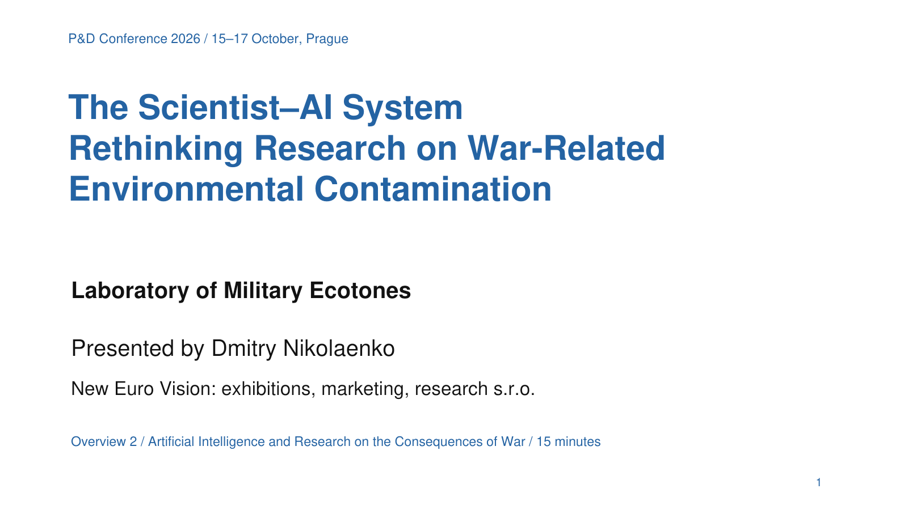
P&D Conference 2026 / 15–17 October, Prague
1 The scientist–AI system
AI supports inquiry across heterogeneous sources
Experts define the problem and check consequential outputs
Project contribution: a common working arrangement
Paper 1 / DOI 10.66659/dz0jgs38
3
Notes:
Slide 3 / Speaker text / Suggested timing 3:00–4:15
The first paper, presented by the Laboratory of Military Ecotones, defines the scientist–AI system as our working arrangement. The expert brings the problem and the judgement required to evaluate results. AI assists comparison and repeated reformulation across material that a small team would otherwise struggle to organise. [1]
For the Vietnamese project, the system could place an archival passage, a historical map and a proposed environmental relationship in one analytical discussion. Their apparent connection would then become a question to examine. The discussion must preserve which statements come from sources and which connections the researcher or AI has proposed.
The practical contribution is an organised way to extend the team's cognitive work. The expert decides which interpretation deserves further investigation and which specialist checks it requires. We should measure the benefit through useful questions, corrected mistakes and better justified next steps. Time spent checking AI output belongs in that assessment.
This paper establishes the research configuration on which the remaining contributions depend.
Sources
[1] Laboratory of Military Ecotones. 2026. The Scientist–AI System: Rethinking Research on War-Related Environmental Contamination. Pollution and Diseases. DOI 10.66659/dz0jgs38 https://pollution-diseases-ojs.org/index.php/pd/article/view/74

Slide 4
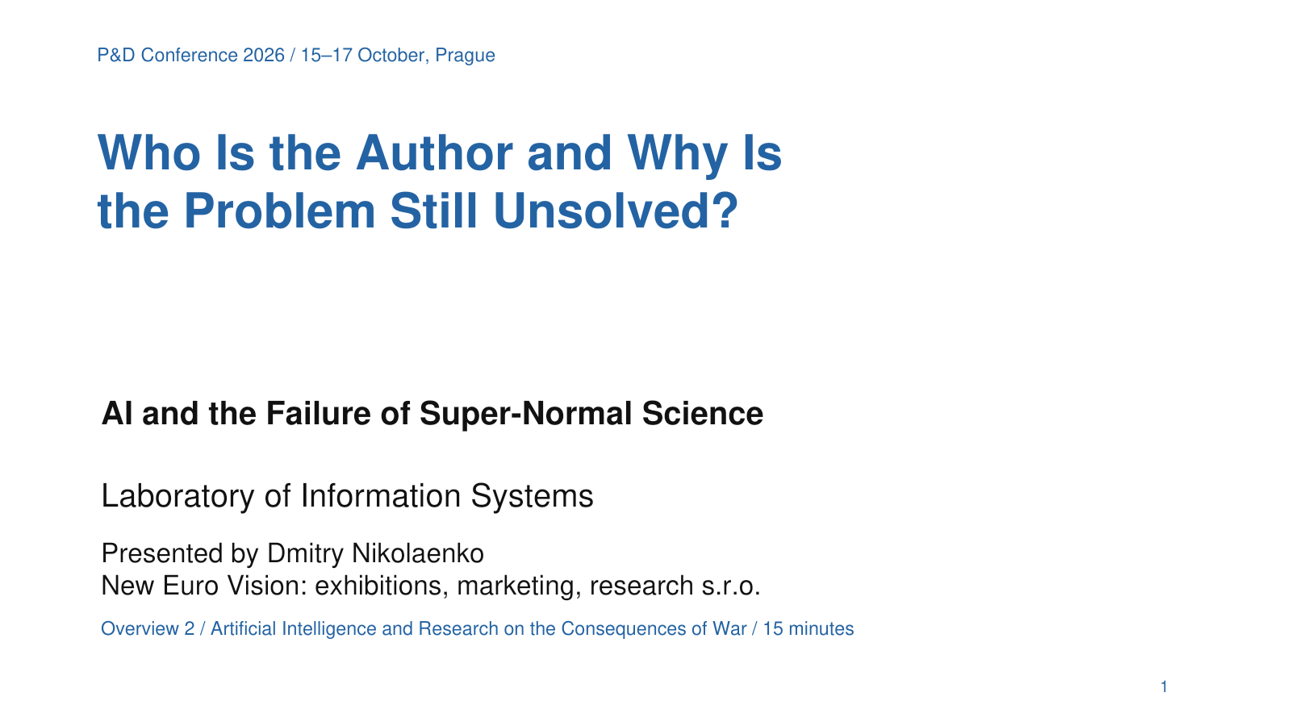
P&D Conference 2026 / 15–17 October, Prague
2 Authorship control and the problem
Control of conclusions requires identifiable responsibility
The problem determines the purpose of the work
Project contribution: named checks and responsible experts
Paper 2 / DOI 10.66659/svj1dy10
4
Notes:
Slide 4 / Speaker text / Suggested timing 4:15–5:30
The second paper, from the Laboratory of Information Systems, examines authorship and the failure of what we call super-normal science. Its central concern is the displacement of the research problem by the preservation of established positions and procedures. This is the paper's critical argument about research organisation. [2]
For project work, we translate that argument into specific questions. Who checked the translation? Who accepted the reconstruction? Who decided that a candidate location justified further expenditure? Who approves the conclusion for publication?
An argument gains scientific standing through its grounds and the examination it survives. Identifying whether a person or AI first suggested a sentence does little to establish those grounds. Human responsibility for the accepted claim must remain identifiable, and consequential AI assistance must remain documented.
In the Vietnamese pilot, an elegant account of a location would still require source checking and comparison with alternatives. The paper therefore directs our attention towards control of conclusions and the contribution to the unresolved problem. These requirements apply to our own laboratories as well.
Sources
[2] Laboratory of Information Systems. 2026. Who Is the Author and Why Is the Problem Still Unsolved? AI and the Failure of Super-Normal Science. Pollution and Diseases. DOI 10.66659/svj1dy10 https://pollution-diseases-ojs.org/index.php/pd/article/view/75

Slide 5
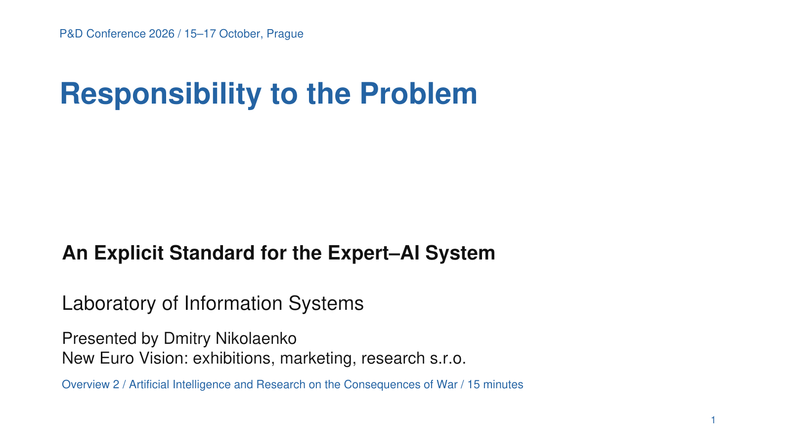
P&D Conference 2026 / 15–17 October, Prague
3 Responsibility to the problem
Understanding the object guides research decisions
Accepted claims retain human responsibility
Project contribution: reasons to proceed revise or stop
Paper 3 / DOI 10.66659/gc495972
5
Notes:
Slide 5 / Speaker text / Suggested timing 5:30–6:45
The third paper states an explicit standard for the expert–AI system. Responsibility begins with a significant unresolved problem and continues through the decisions taken to investigate it. The absence of funding or professional discussion does not remove the work we can responsibly undertake with the means available. [3]
That position also requires recognising the limits of our competence. In a Vietnamese archival project, a participant may understand an administrative record but lack expertise in environmental transport. Another may understand soil processes but be unable to assess the historical terminology. The project must connect these competencies and identify the decisions requiring additional review.
The expert accepts responsibility for the interpretations adopted, published or applied. Where evidence remains incomplete, the record states the unresolved connection and the next useful task.
Under limited resources, this standard helps us choose. We proceed where the proposed action can improve understanding. We revise a task when its assumptions fail. We preserve an important question that we cannot currently answer. Responsibility concerns the object and the evidential consequences of our decisions.
Sources
[3] Laboratory of Information Systems. 2026. Responsibility to the Problem: An Explicit Standard for the Expert–AI System. Pollution and Diseases. DOI 10.66659/gc495972 https://pollution-diseases-ojs.org/index.php/pd/article/view/77

Slide 6
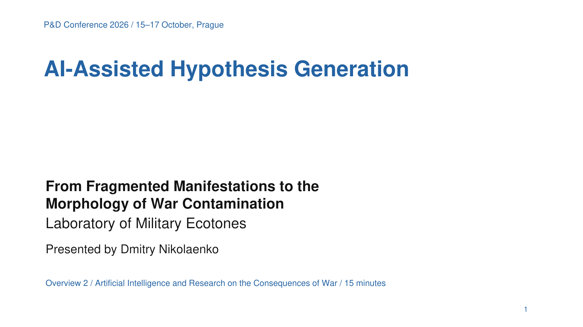
P&D Conference 2026 / 15–17 October, Prague
4 AI assisted hypothesis generation
Dialogue develops competing explanations
Each hypothesis leads to a discriminating test
Project contribution: archive based verification questions
Paper 4 / DOI 10.66659/bap6zf89
6
Notes:
Slide 6 / Speaker text / Suggested timing 6:45–8:00
The fourth paper, from the Laboratory of Military Ecotones, concerns a change in the organisation of hypothesis formation. Sustained discussion with AI can develop an initial question through successive objections and comparisons while retaining the research context. [4]
Suppose documents mention an activity near a river and later records report environmental effects elsewhere. One hypothesis links them through transport. Another points to separate sources. A third questions the location match. AI can help articulate these possibilities and identify assumptions that a first reading overlooked.
The resulting hypotheses do not receive equal credibility automatically. We compare their compatibility with the records and specify the observations that could distinguish them. A useful exchange ends with a clearer question or a testable relationship.
Morphological comparison helps examine distributions and changes through time while the environmental object develops. The project contribution is a set of justified verification questions with a preserved history of revision. A rapidly generated explanation becomes useful when we can inspect its grounds and determine how to challenge it.
Sources
[4] Laboratory of Military Ecotones. 2026. AI-Assisted Hypothesis Generation: From Fragmented Manifestations to the Morphology of War Contamination. Pollution and Diseases. DOI 10.66659/bap6zf89 https://pollution-diseases-ojs.org/index.php/pd/article/view/76

Slide 7
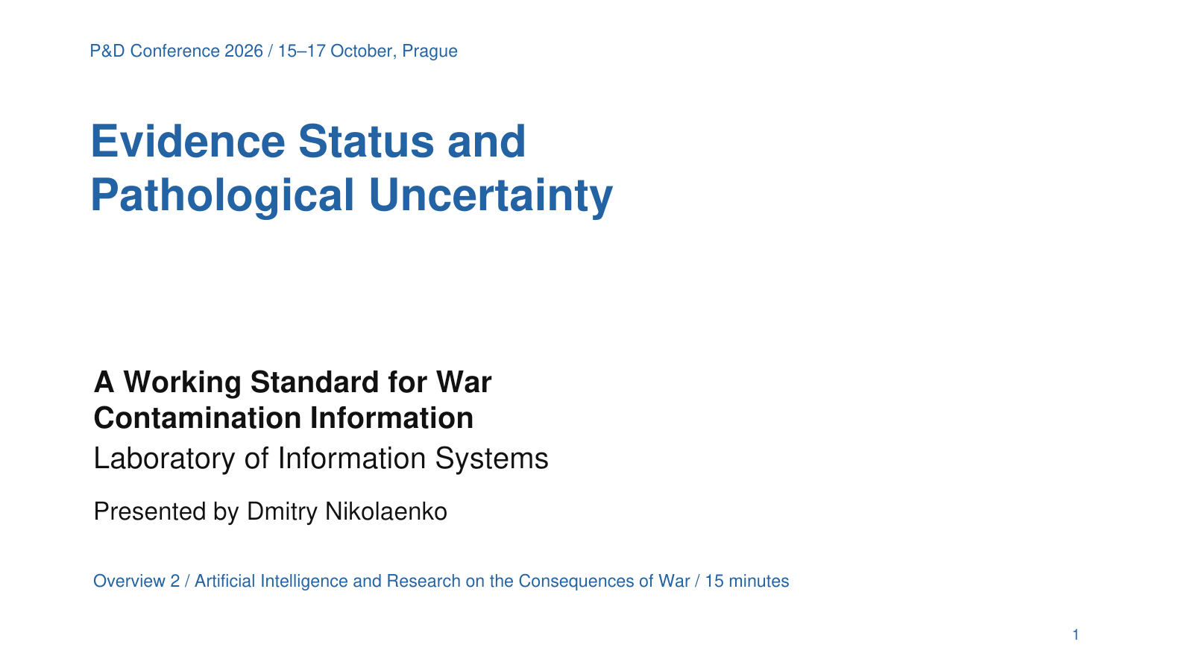
P&D Conference 2026 / 15–17 October, Prague
5 Evidence status and uncertainty
Every claim retains its source status and limits
Different uncertainties require different responses
Project contribution: a traceable evidence record
Paper 5 / DOI 10.66659/z0wwf379
7
Notes:
Slide 7 / Speaker text / Suggested timing 8:00–9:15
The fifth paper supplies the information standard needed throughout this programme. We preserve whether a claim is a documented statement, an observation, a reconstruction or a hypothesis. We also preserve the reason a question remains uncertain. [5]
For the archive pilot, the distinction is immediate. A record may report a chemical operation. Its wording may be ambiguous. A proposed coordinate may depend on interpreting an old place name. A second document may repeat the first rather than independently confirm it. These conditions need different responses.
Uncertainty can also arise because the environmental process has changed since the record was produced. Historical precision cannot by itself settle that later development. The team needs to identify what additional observations could clarify it.
Pathological uncertainty becomes a working problem when different gaps accumulate and their origins disappear. Our response is to make those origins explicit and connect them with research tasks. The evidence record allows participants to challenge an interpretation without losing the source, the earlier assessment or the reasons for revision.
Sources
[5] Laboratory of Information Systems. 2026. Evidence Status and Pathological Uncertainty: A Working Standard for War Contamination Information. Pollution and Diseases. DOI 10.66659/z0wwf379 https://pollution-diseases-ojs.org/index.php/pd/article/view/78

Slide 8
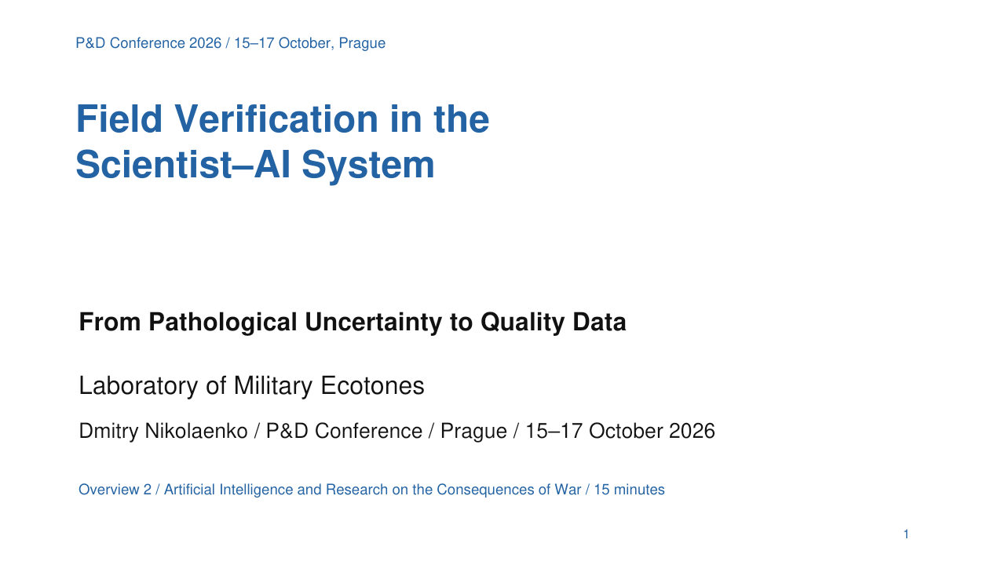
P&D Conference 2026 / 15–17 October, Prague
6 Field verification
Theory makes the purpose of observation explicit
Field evidence can correct hypotheses and boundaries
Project contribution: justified sites methods and tests
Paper 6 / DOI 10.66659/2qwv2037
8
Notes:
Slide 8 / Speaker text / Suggested timing 9:15–10:30
The sixth paper connects the archival and conceptual work to field verification. It asks what we are looking for, why a location is relevant and which result would change our understanding. The Theory of Military Ecotones provides the explicit framework for the proposed environmental investigation. Its assumptions remain open to correction. [6]
In the Vietnamese project, archive analysis would help justify a candidate area. The field design would then distinguish plausible explanations through appropriate observations. Selecting a depth, an environmental compartment or an observation period involves assumptions that the team must state.
Quality data preserve the circumstances of their production. A result needs a location, date, method and the context required to interpret it. AI can assist planning and comparison, while qualified people perform and assess the physical work.
An environmental measurement alone also does not establish a specific health outcome. Each transition towards exposure and harm needs its own evidence. The paper gives the project a reasoned route from documentary uncertainty to observations that can support or reject proposed relationships.
Sources
[6] Laboratory of Military Ecotones. 2026. Field Verification in the Scientist–AI System: From Pathological Uncertainty to Quality Data. Pollution and Diseases. DOI 10.66659/2qwv2037 https://pollution-diseases-ojs.org/index.php/pd/article/view/79

Slide 9
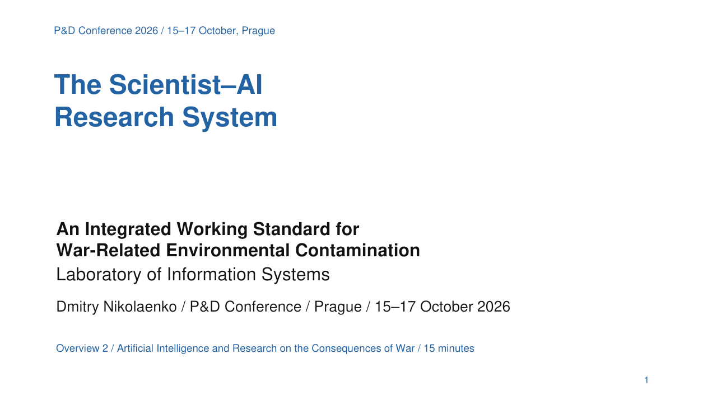
P&D Conference 2026 / 15–17 October, Prague
7 An integrated working standard
Questions evidence and decisions remain connected
New results revise the research programme
Project contribution: continuity under limited resources
Paper 7 / DOI 10.66659/1cabcy23
9
Notes:
Slide 9 / Speaker text / Suggested timing 10:30–11:45
The seventh paper brings the preceding functions into an integrated working standard. A project preserves connections between its questions, sources, hypotheses, observations and decisions. Integration takes place during the work, whenever a new result changes the next action. [7]
For a small Vietnamese pilot, this means another participant can understand why the team selected a document, accepted a place-name interpretation or proposed a site. A contradiction remains available for examination. A rejected hypothesis retains the reason for rejection.
The Laboratory of Information Systems organises this information record. The Laboratory of Military Ecotones develops the environmental questions and verification priorities. Project roles must identify the people and partners able to perform each operation.
AI assists across the cycle, and we evaluate where its contribution helps or creates unnecessary checking. The standard preserves continuity when funding, participants or tools change. The practical result should be a research record that another investigator can examine and continue, including the questions the pilot could not resolve.
Sources
[7] Nikolaenko, Dmitry. 2026. The Scientist–AI Research System: An Integrated Working Standard for War-Related Environmental Contamination. Pollution and Diseases. DOI 10.66659/1cabcy23 https://pollution-diseases-ojs.org/index.php/pd/article/view/80

Slide 10
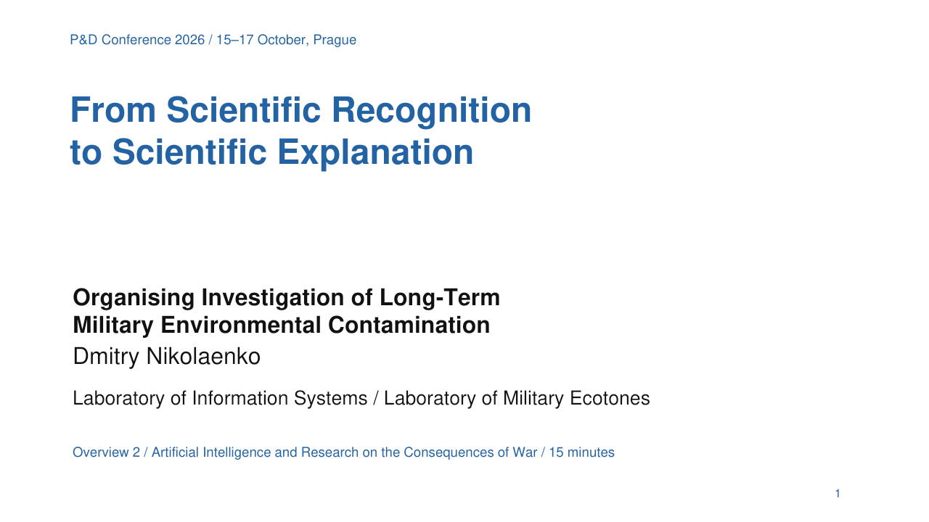
P&D Conference 2026 / 15–17 October, Prague
8 Scientific recognition and explanation
Recognition clarifies the object being investigated
Explanation tests mechanisms and competing accounts
Project contribution: revisable questions and boundaries
Paper 8 / DOI 10.66659/db5ekw49
10
Notes:
Slide 10 / Speaker text / Suggested timing 11:45–13:00
The eighth paper, by Dmitry Nikolaenko, explains why the research system must allow the object itself to become clearer through investigation. Scientific Recognition means progressively identifying its relationships and working boundaries. Scientific Explanation addresses how the process operates. These activities interact throughout the work. [8]
The Vietnamese pilot may begin with a location and discover that a relevant pathway extends beyond it. It may instead show that observations originally grouped together concern different processes. Either result can improve recognition and change the research design.
The Scientific Recognition Architecture allows preliminary explanations to guide inquiry while keeping their authority within stated evidential limits. A coherent pattern still requires causal testing. A mature explanation retains the conditions under which it applies. [11]
This final paper gives the programme its methodological openness. The team must preserve what changed in its understanding, which explanation became better supported and what remains unresolved. Completing the pilot should leave the next investigator a clearer object and a more usable basis for continuing the inquiry.
Sources
[8] Nikolaenko, Dmitry. 2026. From Scientific Recognition to Scientific Explanation: Organising Investigation of Long-Term Military Environmental Contamination. Pollution and Diseases. DOI 10.66659/db5ekw49 https://pollution-diseases-ojs.org/index.php/pd/article/view/58
[11] Nikolaenko, Dmitry. 2026. Scientific Recognition Architecture. Operational Specification Version 1.0. Pollution and Diseases. DOI 10.66659/q52haz36 https://pollution-diseases-ojs.org/index.php/pd/article/view/61

Slide 11
P&D Conference 2026 / 15–17 October, Prague
The organisation of inquiry
Paper 1 establishes the scientist–AI working arrangement
Papers 2 and 3 make control and responsibility explicit
Paper 7 connects operations and preserves their grounds
The object determines which expertise the project needs
11
Notes:
Slide 11 / Speaker text / Suggested timing 13:00–14:30
We can now see the first part of the series' common logic: the organisation of inquiry. Paper one defines the working arrangement with AI. Paper two asks what controls the conclusions and whether the problem remains central. Paper three makes responsibility explicit. Paper seven connects these obligations with the operation of a small project. [1–3, 7]
The resulting organisation follows the relationships we need to investigate. An archivist evaluates the document. A language specialist helps resolve a significant expression. An environmental researcher examines the proposed pathway. The coordinating expert identifies where these judgements meet and where another competence is required.
AI can assist the comparison between these perspectives. It cannot create the absent specialist competence simply by producing an answer in that discipline's vocabulary. We therefore record which checks participants performed and which remain outstanding.
The conference helps clarify these requirements before implementation. Its achievement includes more precise questions and an explicit programme that prospective participants can examine. The next assessment concerns actual project performance. Can the team preserve its reasons, correct errors and select a useful next action under its available resources?
This is why the eight papers belong together. Their organisational requirements make the proposed research operations accountable and allow the work to continue across specialties.
Sources
[1] Laboratory of Military Ecotones. 2026. The Scientist–AI System: Rethinking Research on War-Related Environmental Contamination. Pollution and Diseases. DOI 10.66659/dz0jgs38 https://pollution-diseases-ojs.org/index.php/pd/article/view/74
[2] Laboratory of Information Systems. 2026. Who Is the Author and Why Is the Problem Still Unsolved? AI and the Failure of Super-Normal Science. Pollution and Diseases. DOI 10.66659/svj1dy10 https://pollution-diseases-ojs.org/index.php/pd/article/view/75
[3] Laboratory of Information Systems. 2026. Responsibility to the Problem: An Explicit Standard for the Expert–AI System. Pollution and Diseases. DOI 10.66659/gc495972 https://pollution-diseases-ojs.org/index.php/pd/article/view/77
[7] Nikolaenko, Dmitry. 2026. The Scientist–AI Research System: An Integrated Working Standard for War-Related Environmental Contamination. Pollution and Diseases. DOI 10.66659/1cabcy23 https://pollution-diseases-ojs.org/index.php/pd/article/view/80

Slide 12
P&D Conference 2026 / 15–17 October, Prague
The developing research cycle
Paper 5 preserves the evidential status of archival claims
Paper 4 develops alternatives and proposed tests
Paper 6 produces observations that can change the account
Paper 8 revises the recognised object and explanation
12
Notes:
Slide 12 / Speaker text / Suggested timing 14:30–16:00
The second part of the logic concerns the developing investigation. The archive supplies statements with particular histories. Paper five keeps their status visible. Paper four helps turn unresolved relationships into competing hypotheses. Paper six directs observations towards those differences. Paper eight asks what became clearer about the object and its explanation. [4–6, 8]
The cycle includes return and correction. A field result may lead us back to a document whose place name we misunderstood. An archival contradiction may remove the justification for sampling. A new pathway may require expertise or a location beyond the initial project scope.
We preserve the change and its grounds in the integrated record. This allows a project to make a bounded conclusion while retaining questions for later work. It also prevents a plausible reconstruction from silently becoming an established finding.
For the proposed Vietnamese pilot, the first reviewable result could be a verified documentary reconstruction, a rejected location match or a field question with a defensible rationale. We should select a limited corpus and one question, then evaluate the entire cycle on that basis. Expansion follows what the pilot establishes and the partnerships available.
The purpose of the common system is cumulative understanding. Each action should leave the object better described or the remaining uncertainty more specifically connected with a possible investigation.
Sources
[4] Laboratory of Military Ecotones. 2026. AI-Assisted Hypothesis Generation: From Fragmented Manifestations to the Morphology of War Contamination. Pollution and Diseases. DOI 10.66659/bap6zf89 https://pollution-diseases-ojs.org/index.php/pd/article/view/76
[5] Laboratory of Information Systems. 2026. Evidence Status and Pathological Uncertainty: A Working Standard for War Contamination Information. Pollution and Diseases. DOI 10.66659/z0wwf379 https://pollution-diseases-ojs.org/index.php/pd/article/view/78
[6] Laboratory of Military Ecotones. 2026. Field Verification in the Scientist–AI System: From Pathological Uncertainty to Quality Data. Pollution and Diseases. DOI 10.66659/2qwv2037 https://pollution-diseases-ojs.org/index.php/pd/article/view/79
[7] Nikolaenko, Dmitry. 2026. The Scientist–AI Research System: An Integrated Working Standard for War-Related Environmental Contamination. Pollution and Diseases. DOI 10.66659/1cabcy23 https://pollution-diseases-ojs.org/index.php/pd/article/view/80
[8] Nikolaenko, Dmitry. 2026. From Scientific Recognition to Scientific Explanation: Organising Investigation of Long-Term Military Environmental Contamination. Pollution and Diseases. DOI 10.66659/db5ekw49 https://pollution-diseases-ojs.org/index.php/pd/article/view/58

Slide 13
P&D Conference 2026 / 15–17 October, Prague
Preparation for effective AI research
Participants define the question and provide usable context
They compare alternatives and check source passages
The shared record preserves revisions and decision owners
Performance depends on users tools evidence and verification
13
Notes:
Slide 13 / Speaker text / Suggested timing 16:00–17:30
Effective use of AI requires preparation. A participant needs to formulate the research question, supply relevant context and distinguish the operations being requested. Extracting what a passage says, translating its wording and proposing an environmental explanation are different tasks. Their results need different checks.
AI can act partly as a mirror of the user's framing. A vague question or an unexamined assumption may return in fluent, expanded form. We use this as a working metaphor for the interaction, rather than a complete description of the technology. A weak use of AI reveals a weakness in the arrangement between the user, the task and the tool. It cannot settle the capability of AI in general.
Preparation therefore includes asking what would challenge the preferred interpretation, comparing the answer with the source and documenting the consequential revision. A participant must also recognise when a question requires specialist judgement or a physical observation.
The user has substantial influence over the quality of this work. Model capabilities, source quality and verification also matter. Even a well-prepared expert can receive an erroneous answer. Our standard makes checking and correction part of normal project activity.
We will assess learning through work on project material: a checked claim, a justified alternative or a decision whose grounds another participant can inspect. The outcome is competence in a shared research procedure. [1, 3–7]
Sources
[1] Laboratory of Military Ecotones. 2026. The Scientist–AI System: Rethinking Research on War-Related Environmental Contamination. Pollution and Diseases. DOI 10.66659/dz0jgs38 https://pollution-diseases-ojs.org/index.php/pd/article/view/74
[3] Laboratory of Information Systems. 2026. Responsibility to the Problem: An Explicit Standard for the Expert–AI System. Pollution and Diseases. DOI 10.66659/gc495972 https://pollution-diseases-ojs.org/index.php/pd/article/view/77
[4] Laboratory of Military Ecotones. 2026. AI-Assisted Hypothesis Generation: From Fragmented Manifestations to the Morphology of War Contamination. Pollution and Diseases. DOI 10.66659/bap6zf89 https://pollution-diseases-ojs.org/index.php/pd/article/view/76
[5] Laboratory of Information Systems. 2026. Evidence Status and Pathological Uncertainty: A Working Standard for War Contamination Information. Pollution and Diseases. DOI 10.66659/z0wwf379 https://pollution-diseases-ojs.org/index.php/pd/article/view/78
[6] Laboratory of Military Ecotones. 2026. Field Verification in the Scientist–AI System: From Pathological Uncertainty to Quality Data. Pollution and Diseases. DOI 10.66659/2qwv2037 https://pollution-diseases-ojs.org/index.php/pd/article/view/79
[7] Nikolaenko, Dmitry. 2026. The Scientist–AI Research System: An Integrated Working Standard for War-Related Environmental Contamination. Pollution and Diseases. DOI 10.66659/1cabcy23 https://pollution-diseases-ojs.org/index.php/pd/article/view/80

Slide 14
P&D Conference 2026 / 15–17 October, Prague
Online learning across disciplines and languages
Online sessions use shared project documents and exercises
Participants can work in their native or strongest languages
AI supports translation with a checked common glossary
Participation rests on expertise and willingness to learn
14
Notes:
Slide 14 / Speaker text / Suggested timing 17:30–19:00
The preparatory work can take place online. Participants can examine shared documents, discuss AI outputs and compare interpretations without travelling to one meeting place. Sessions can combine scheduled discussion with exercises completed when participants have time. Field observations remain organised where the environmental work requires them.
The training must also address differences between specialties. Participants need to understand what another discipline's evidence establishes and where its limits begin. Working on the same archival fragment and proposed relationship will reveal those differences more clearly than a general demonstration of AI features.
We intend to support learning and contribution in participants' native or strongest working languages. AI-assisted translation can help connect those contributions with the common project record. Participants should have room to develop a precise argument before preparing its shared-language version.
This requires checking. UNESCO notes that many languages remain underrepresented in AI systems. We must assess the tools for the languages involved, maintain a common glossary and verify translations that affect a consequential interpretation. We cannot promise equal performance for every language. [12]
Excellent English will not be a general entry requirement. A TOEFL certificate will not be required for participation in this programme. Subject expertise, willingness to learn and the ability to follow the shared checking procedure will guide participation. The project organisation must provide the language support needed for effective collaboration.
Sources
[3] Laboratory of Information Systems. 2026. Responsibility to the Problem: An Explicit Standard for the Expert–AI System. Pollution and Diseases. DOI 10.66659/gc495972 https://pollution-diseases-ojs.org/index.php/pd/article/view/77
[7] Nikolaenko, Dmitry. 2026. The Scientist–AI Research System: An Integrated Working Standard for War-Related Environmental Contamination. Pollution and Diseases. DOI 10.66659/1cabcy23 https://pollution-diseases-ojs.org/index.php/pd/article/view/80
[12] UNESCO. Coalition for Linguistic Diversity in Artificial Intelligence. Global AI Ethics and Governance Observatory. Accessed 11 October 2026. https://www.unesco.org/ethics-ai/en/coalition-linguistic-diversity-artificial-intelligence

Slide 15
P&D Conference 2026 / 15–17 October, Prague
Sources 1–4
[1] Series 1 / The Scientist–AI System
DOI 10.66659/dz0jgs38
[2] Series 2 / Authorship and control
DOI 10.66659/svj1dy10
[3] Series 3 / Responsibility to the Problem
DOI 10.66659/gc495972
[4] Series 4 / AI-Assisted Hypothesis Generation
DOI 10.66659/bap6zf89
15
Notes:
Slide 15 / Reference material / Suggested timing 19:00–19:00
Sources
[1] Laboratory of Military Ecotones. 2026. The Scientist–AI System: Rethinking Research on War-Related Environmental Contamination. Pollution and Diseases. DOI 10.66659/dz0jgs38 https://pollution-diseases-ojs.org/index.php/pd/article/view/74
[2] Laboratory of Information Systems. 2026. Who Is the Author and Why Is the Problem Still Unsolved? AI and the Failure of Super-Normal Science. Pollution and Diseases. DOI 10.66659/svj1dy10 https://pollution-diseases-ojs.org/index.php/pd/article/view/75
[3] Laboratory of Information Systems. 2026. Responsibility to the Problem: An Explicit Standard for the Expert–AI System. Pollution and Diseases. DOI 10.66659/gc495972 https://pollution-diseases-ojs.org/index.php/pd/article/view/77
[4] Laboratory of Military Ecotones. 2026. AI-Assisted Hypothesis Generation: From Fragmented Manifestations to the Morphology of War Contamination. Pollution and Diseases. DOI 10.66659/bap6zf89 https://pollution-diseases-ojs.org/index.php/pd/article/view/76

Slide 16
P&D Conference 2026 / 15–17 October, Prague
Sources 5–8
[5] Series 5 / Evidence Status and Pathological Uncertainty
DOI 10.66659/z0wwf379
[6] Series 6 / Field Verification
DOI 10.66659/2qwv2037
[7] Series 7 / The Integrated Working Standard
DOI 10.66659/1cabcy23
[8] Methodological article / Scientific Recognition and Explanation
DOI 10.66659/db5ekw49
16
Notes:
Slide 16 / Reference material / Suggested timing 19:00–19:00
Sources
[5] Laboratory of Information Systems. 2026. Evidence Status and Pathological Uncertainty: A Working Standard for War Contamination Information. Pollution and Diseases. DOI 10.66659/z0wwf379 https://pollution-diseases-ojs.org/index.php/pd/article/view/78
[6] Laboratory of Military Ecotones. 2026. Field Verification in the Scientist–AI System: From Pathological Uncertainty to Quality Data. Pollution and Diseases. DOI 10.66659/2qwv2037 https://pollution-diseases-ojs.org/index.php/pd/article/view/79
[7] Nikolaenko, Dmitry. 2026. The Scientist–AI Research System: An Integrated Working Standard for War-Related Environmental Contamination. Pollution and Diseases. DOI 10.66659/1cabcy23 https://pollution-diseases-ojs.org/index.php/pd/article/view/80
[8] Nikolaenko, Dmitry. 2026. From Scientific Recognition to Scientific Explanation: Organising Investigation of Long-Term Military Environmental Contamination. Pollution and Diseases. DOI 10.66659/db5ekw49 https://pollution-diseases-ojs.org/index.php/pd/article/view/58

Slide 17
P&D Conference 2026 / 15–17 October, Prague
Sources 9–12
[9] Vietnamese archives / National Archives Center III
DOI 10.66659/xnkh0w22
[10] Vietnamese archives / National Archives Center II
DOI 10.66659/zdcj2c76
[11] Scientific Recognition Architecture / Specification 1.0
DOI 10.66659/q52haz36
[12] UNESCO / Linguistic diversity in AI
unesco.org / Global AI Ethics and Governance Observatory
17
Notes:
Slide 17 / Reference material / Suggested timing 19:00–19:00
Sources
[9] Vu Thi Phung, Vu Dinh Phong, and Nguyen Van Ngoc. 2026. Archival records at National Archives Center III on the use of chemical agents during the Vietnam War: value and accessibility. Pollution and Diseases. DOI 10.66659/xnkh0w22 https://pollution-diseases-ojs.org/index.php/pd/article/view/99
[10] Cu Thi Dung and Vu Dinh Phong. 2026. Archival sources of the Government of the Republic of Vietnam at National Archives Center II on chemical defoliants during the Vietnam War. Pollution and Diseases. DOI 10.66659/zdcj2c76 https://pollution-diseases-ojs.org/index.php/pd/article/view/100
[11] Nikolaenko, Dmitry. 2026. Scientific Recognition Architecture. Operational Specification Version 1.0. Pollution and Diseases. DOI 10.66659/q52haz36 https://pollution-diseases-ojs.org/index.php/pd/article/view/61
[12] UNESCO. Coalition for Linguistic Diversity in Artificial Intelligence. Global AI Ethics and Governance Observatory. Accessed 11 October 2026. https://www.unesco.org/ethics-ai/en/coalition-linguistic-diversity-artificial-intelligence

Slide 18
P&D Conference 2026 / 15–17 October, Prague
Our commitment to preparing the team
The Laboratory of Information Systems and the Laboratory
of Military Ecotones will organise practical online training
The first project is provisionally focused on Vietnam
We will support native-language participation with terminology checks
Excellent English and a TOEFL certificate are not entry requirements
18
Notes:
Slide 18 / Speaker text / Suggested timing 19:00–20:00
The Laboratory of Information Systems and the Laboratory of Military Ecotones will organise practical online training as part of preparation for the first project, provisionally focused on Vietnam. The two laboratories take responsibility for organising the learning process and arranging the subject and language checks it requires.
We will work with project documents and research questions, support participation in native or strongest working languages, and maintain shared procedures for source verification. Training will continue as project work reveals new needs. We will assess progress through the participants' research tasks and the inspectable decisions they produce.
Our first step is a limited archival pilot with an explicit question. The eight papers provide its working foundation. Preparation of the team makes that foundation usable in an international project.
Sources
[1] Laboratory of Military Ecotones. 2026. The Scientist–AI System: Rethinking Research on War-Related Environmental Contamination. Pollution and Diseases. DOI 10.66659/dz0jgs38 https://pollution-diseases-ojs.org/index.php/pd/article/view/74
[3] Laboratory of Information Systems. 2026. Responsibility to the Problem: An Explicit Standard for the Expert–AI System. Pollution and Diseases. DOI 10.66659/gc495972 https://pollution-diseases-ojs.org/index.php/pd/article/view/77
[7] Nikolaenko, Dmitry. 2026. The Scientist–AI Research System: An Integrated Working Standard for War-Related Environmental Contamination. Pollution and Diseases. DOI 10.66659/1cabcy23 https://pollution-diseases-ojs.org/index.php/pd/article/view/80

