Slide 1
OVERVIEW 3 / P&D CONFERENCE / 17 OCTOBER 2026
Complex Ecological Relationships
and the Environmental Legacies
of Dioxin
Research on New Zealand dolphins and competing explanations
as an example of refusal to investigate complex ecological relationships
and repetition of previously established findings
Dmitry Nikolaenko
Editor-in-Chief, Pollution and Diseases
Thematic overview of three contributions / 20 minutes
1
Notes:
Suggested speaking time: 59 seconds
This overview examines three contributions on Hector’s and Māui dolphins. Together they raise a question about the production of scientific knowledge: what happens when a research programme develops one explanation extensively while leaving consequential ecological connections unresolved? I present this as a fourth, independent contribution. It draws on the three papers and on five questions developed through an Expert–AI inquiry. My position is direct. Scientific authority must itself become an object of investigation when it controls the opportunities to examine competing causes. We cannot promise to save the world. We can describe how it changes, which processes remain unexamined, and which decisions shape what becomes scientifically visible. The detailed theory and methodology of complex ecological relationships will be developed in a separate work.
Sources: https://pollution-diseases-ojs.org/index.php/pd/article/view/39
https://pollution-diseases-ojs.org/index.php/pd/article/view/44
https://pollution-diseases-ojs.org/index.php/pd/article/view/29
Protocol basis: Expert–AI discussion with Dmitry Nikolaenko, 10 October 2026, questions 1–5. The observations of prolonged silence are the expert’s reported experience. Socialisation mechanisms and response forecasts are analytical hypotheses. Deliberate suppression is Gibbs’s accusation, requiring documentary investigation. The supplied decks do not establish a funding share, a coordinated campaign or wartime-source causation of population decline. Presentation roles and publication authorship differ.

Slide 2
PROTOCOL POSITION
The object and the interests of its researchers
Ecological change continues regardless of scientific recognition.
A conservation mission does not establish explanatory adequacy.
Professional stability and population recovery are different outcomes.
Institutional decisions belong within the investigation.
2
Notes:
Suggested speaking time: 62 seconds
The starting point is the separation between the object of research and the interests of those researching it. A population follows biological and environmental processes. Researchers operate within institutions that allocate employment, resources and authority. Their declared commitment to conservation cannot establish that their programme adequately explains those processes. This overview therefore asks what the programme investigates, what it excludes, and how it responds when outsiders challenge those boundaries. The three presentations supply different parts of the argument. Our protocol adds the questions about recognition, protective behaviour and accountability. It does not treat every researcher as sharing one motive. It examines decisions and their effects. Nor does it assume that criticism proves the chemical explanation. The ecological claim and the institutional accusation must each face their own evidence.
Sources: https://pollution-diseases-ojs.org/index.php/pd/article/view/39
https://pollution-diseases-ojs.org/index.php/pd/article/view/44
https://pollution-diseases-ojs.org/index.php/pd/article/view/29
Protocol basis: Expert–AI discussion with Dmitry Nikolaenko, 10 October 2026, questions 1–5. The observations of prolonged silence are the expert’s reported experience. Socialisation mechanisms and response forecasts are analytical hypotheses. Deliberate suppression is Gibbs’s accusation, requiring documentary investigation. The supplied decks do not establish a funding share, a coordinated campaign or wartime-source causation of population decline. Presentation roles and publication authorship differ.

Slide 3
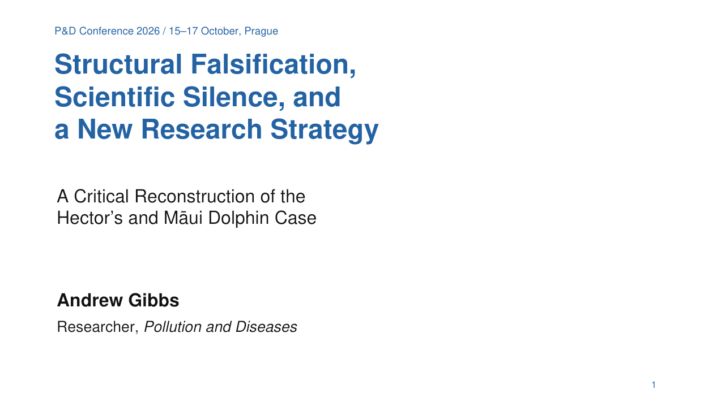
Notes:
Suggested speaking time: 21 seconds
The first contribution is Andrew Gibbs’s Structural Falsification, Scientific Silence, and a New Research Strategy: A Critical Reconstruction of the Hector’s and Māui Dolphin Case. Its central subject is the exclusion of relevant evidence and the research obligations created by a technical archive.
Sources: https://pollution-diseases-ojs.org/index.php/pd/article/view/39
Protocol basis: Expert–AI discussion with Dmitry Nikolaenko, 10 October 2026, questions 1–5. The observations of prolonged silence are the expert’s reported experience. Socialisation mechanisms and response forecasts are analytical hypotheses. Deliberate suppression is Gibbs’s accusation, requiring documentary investigation. The supplied decks do not establish a funding share, a coordinated campaign or wartime-source causation of population decline. Presentation roles and publication authorship differ.

Slide 4
CONTRIBUTION 1 / MAIN IDEA
Exclusion can distort an accurate scientific record
The paper reconstructs technical investigations in 1995–1996.
It examines delayed availability and use of the archive.
Source records require transport, exposure and biological tests.
Structural falsification is the authors’ diagnosis of systematic exclusion.
4
Notes:
Suggested speaking time: 75 seconds
The first paper’s central idea is that a scientific picture can become systematically distorted while individual measurements remain accurate. The paper reconstructs the creation of Paritutu technical records in 1995 and 1996, their public availability in 2024, and the question of their subsequent scientific use. Creation, accessibility, citation and actual use in research are different events. A report about contaminated soil or groundwater establishes a starting point for source investigation. It does not establish a dolphin population effect. The missing work connects candidate sources with coastal transport, marine food webs, exposure and biological outcomes. The authors call the long-term exclusion of consequential connections structural falsification. This is an analytical diagnosis of the organisation of knowledge. It does not mean that every underlying observation was fabricated. The paper demands a reconstruction of both the environmental pathway and the history of its recognition. A programme cannot present an untested pathway as a pathway it has scientifically rejected.
Sources: https://pollution-diseases-ojs.org/index.php/pd/article/view/39
Protocol basis: Expert–AI discussion with Dmitry Nikolaenko, 10 October 2026, questions 1–5. The observations of prolonged silence are the expert’s reported experience. Socialisation mechanisms and response forecasts are analytical hypotheses. Deliberate suppression is Gibbs’s accusation, requiring documentary investigation. The supplied decks do not establish a funding share, a coordinated campaign or wartime-source causation of population decline. Presentation roles and publication authorship differ.

Slide 5
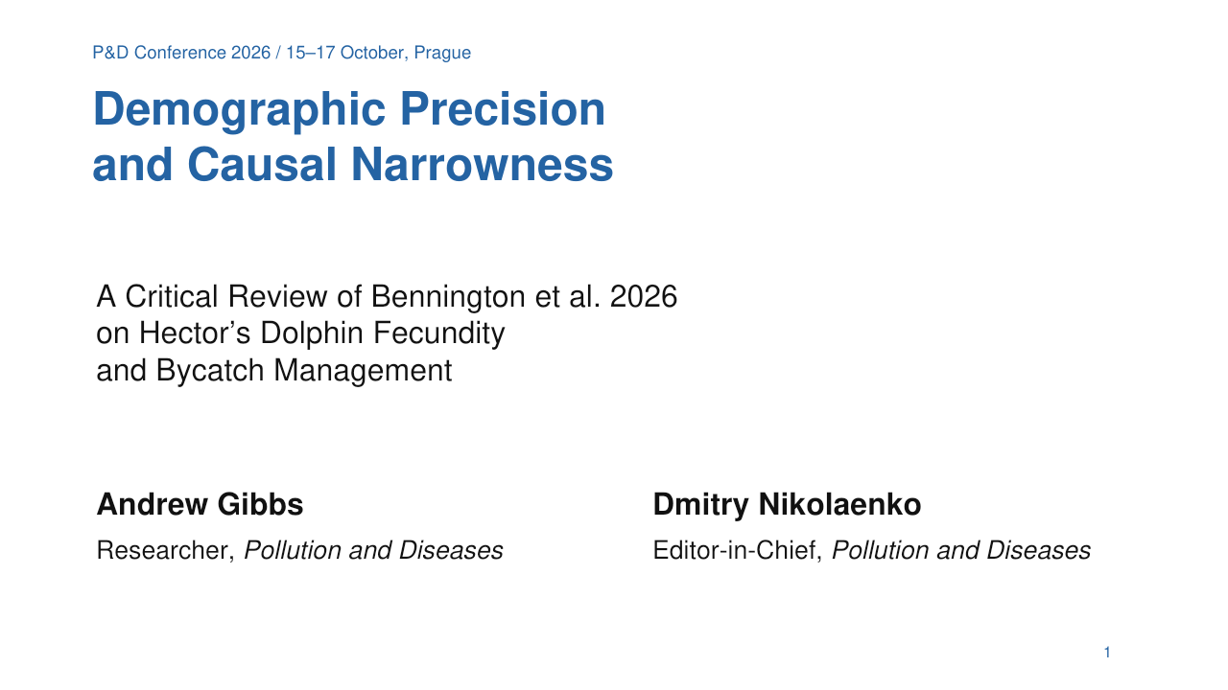
Notes:
Suggested speaking time: 18 seconds
The second contribution is Andrew Gibbs and Dmitry Nikolaenko’s Demographic Precision and Causal Narrowness: A Critical Review of Bennington et al. 2026 on Hector’s Dolphin Fecundity and Bycatch Management. It separates a demographic estimate from a causal explanation.
Sources: https://pollution-diseases-ojs.org/index.php/pd/article/view/44
Protocol basis: Expert–AI discussion with Dmitry Nikolaenko, 10 October 2026, questions 1–5. The observations of prolonged silence are the expert’s reported experience. Socialisation mechanisms and response forecasts are analytical hypotheses. Deliberate suppression is Gibbs’s accusation, requiring documentary investigation. The supplied decks do not establish a funding share, a coordinated campaign or wartime-source causation of population decline. Presentation roles and publication authorship differ.

Slide 6
CONTRIBUTION 2 / MAIN IDEA
A precise parameter cannot identify an omitted cause
Bennington et al. estimate fecundity at 0.291 per mature female per year.
The previous estimate was 0.409. This is a comparison of analyses.
The fitted demographic model supplies no environmental causal ranking.
Lower mortality tolerance does not identify the cause of low fecundity.
6
Notes:
Suggested speaking time: 75 seconds
The second paper identifies a different boundary. Bennington and colleagues estimate fecundity at approximately 0.291 offspring per mature female per year, compared with the earlier estimate of 0.409. The difference between analyses is not, by itself, evidence that fecundity declined by thirty percent through time. The model addresses imperfect observations in a long-term Banks Peninsula photo-identification record. That is a substantive demographic task. It does not fit environmental causal covariates that could explain the reproductive outcome. A lower reproductive estimate can imply less tolerance of additional mortality. It cannot establish which processes produced low reproduction or rank all causes of the population problem. The review challenges the additional explanatory authority that a restricted result can acquire within a wider bycatch-centred programme. It does not claim that the original model demonstrates a single-cause explanation. Its central criticism is that repeated refinement inside a framework can coexist with a persistent failure to investigate the framework’s missing causal connections.
Sources: https://pollution-diseases-ojs.org/index.php/pd/article/view/44
https://doi.org/10.1111/csp2.70242
Protocol basis: Expert–AI discussion with Dmitry Nikolaenko, 10 October 2026, questions 1–5. The observations of prolonged silence are the expert’s reported experience. Socialisation mechanisms and response forecasts are analytical hypotheses. Deliberate suppression is Gibbs’s accusation, requiring documentary investigation. The supplied decks do not establish a funding share, a coordinated campaign or wartime-source causation of population decline. Presentation roles and publication authorship differ.

Slide 7
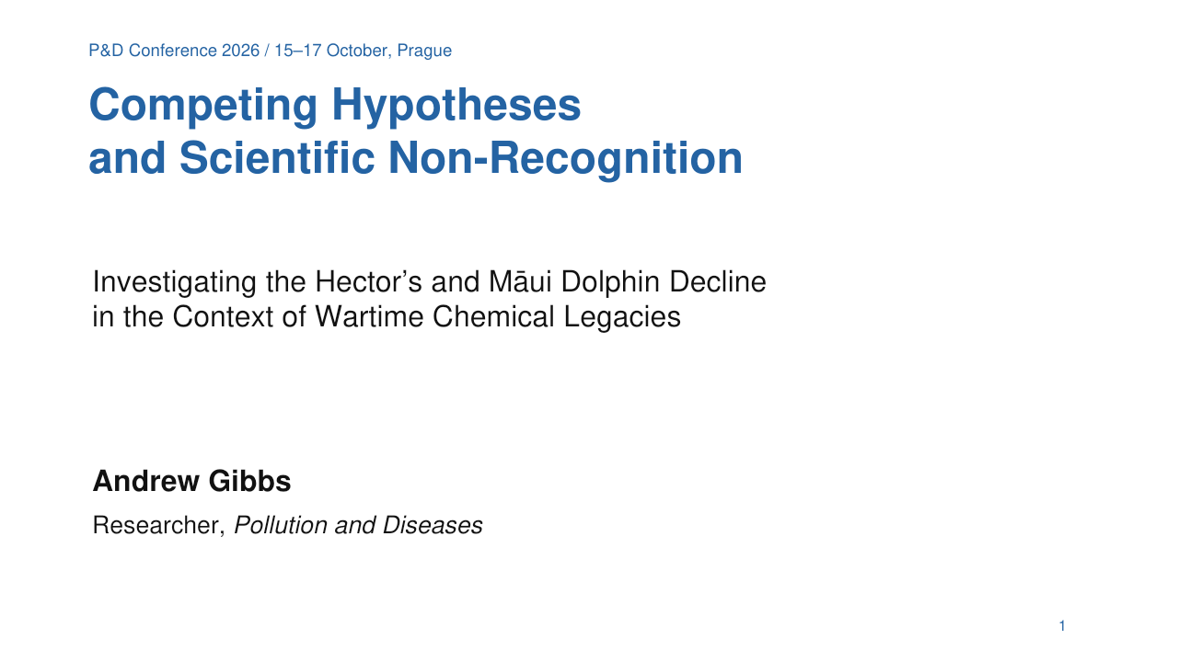
Notes:
Suggested speaking time: 21 seconds
The third contribution is Andrew Gibbs’s Competing Hypotheses and Scientific Non-Recognition: Investigating the Hector’s and Māui Dolphin Decline in the Context of Wartime Chemical Legacies. This presentation makes an explicit accusation of deliberate suppression and identifies the separate investigation needed to examine it.
Sources: https://pollution-diseases-ojs.org/index.php/pd/article/view/29
Protocol basis: Expert–AI discussion with Dmitry Nikolaenko, 10 October 2026, questions 1–5. The observations of prolonged silence are the expert’s reported experience. Socialisation mechanisms and response forecasts are analytical hypotheses. Deliberate suppression is Gibbs’s accusation, requiring documentary investigation. The supplied decks do not establish a funding share, a coordinated campaign or wartime-source causation of population decline. Presentation roles and publication authorship differ.

Slide 8
CONTRIBUTION 3 / MAIN IDEA
The accusation concerns who can obtain a causal test
Gibbs accuses gatekeepers of deliberate suppression of inquiry.
Official assessments already acknowledge pollution and interactions.
Wartime source attribution and population effects remain unresolved.
Intent requires a documentary inquiry into decisions and reasons.
8
Notes:
Suggested speaking time: 75 seconds
The third presentation makes the accusation openly: gatekeepers deliberately suppress inconvenient scientific inquiry to protect a preferred explanation. The overview records that accusation without presenting it as an established finding about identifiable people. Its examination requires records of knowledge, decisions, access restrictions and reasons. The ecological evidence needs equally careful treatment. Official assessments already acknowledge pollution and interacting threats. Claiming that nobody has ever recognised pollutants would misdescribe the record. The disputed issue is whether recognition produces an integrated causal investigation. Chemical exposure does not by itself identify a wartime source or establish its contribution to decline. Paritutu cannot become an automatic explanation for geographically different populations. Source attribution requires chemical profiles and credible transport histories for the populations concerned. The presentation therefore combines a strong institutional accusation with specific tests of that accusation and of the chemical hypothesis. Its main demand is access to a fair test, rather than acceptance of an explanation by authority.
Sources: https://pollution-diseases-ojs.org/index.php/pd/article/view/29
Protocol basis: Expert–AI discussion with Dmitry Nikolaenko, 10 October 2026, questions 1–5. The observations of prolonged silence are the expert’s reported experience. Socialisation mechanisms and response forecasts are analytical hypotheses. Deliberate suppression is Gibbs’s accusation, requiring documentary investigation. The supplied decks do not establish a funding share, a coordinated campaign or wartime-source causation of population decline. Presentation roles and publication authorship differ.

Slide 9
SYNTHESIS
Three contributions expose three research boundaries
Structural analysis: which consequential records enter research?
Demographic review: what can the fitted model actually explain?
Recognition analysis: who enables or prevents competing tests?
Our overview asks how these boundaries become institutionally durable.
9
Notes:
Suggested speaking time: 70 seconds
The papers converge on a problem larger than a disagreement about one pollutant. The first examines which records and connections enter the scientific picture. The second examines the causal reach of a precise model. The third examines the institutional conditions under which competing explanations receive a test. Together they distinguish evidence production from explanatory authority. Extensive research on one factor cannot make every unexamined factor irrelevant. Conversely, finding a gap does not prove the critic’s preferred explanation. The common requirement is to identify the missing test and the decisions that determine whether it can occur. Our overview then asks why those boundaries persist. The five questions that follow emerged from the Expert–AI discussion. They retain the distinction between the expert’s observations, analytical explanations and forecasts. The inquiry treats the research community itself as an object, while keeping the natural process independently answerable to evidence.
Sources: https://pollution-diseases-ojs.org/index.php/pd/article/view/39
https://pollution-diseases-ojs.org/index.php/pd/article/view/44
https://pollution-diseases-ojs.org/index.php/pd/article/view/29
Protocol basis: Expert–AI discussion with Dmitry Nikolaenko, 10 October 2026, questions 1–5. The observations of prolonged silence are the expert’s reported experience. Socialisation mechanisms and response forecasts are analytical hypotheses. Deliberate suppression is Gibbs’s accusation, requiring documentary investigation. The supplied decks do not establish a funding share, a coordinated campaign or wartime-source causation of population decline. Presentation roles and publication authorship differ.

Slide 10
PROTOCOL / QUESTION 1
Inside expertise and outside recognition
Specialist competence can coexist with a restricted causal frame.
Separate disciplines can leave ecological connections without an owner.
Outside criticism can expose the boundary of the programme.
The missing test and the proposed explanation need separate evaluation.
10
Notes:
Suggested speaking time: 79 seconds
Expert question: Why can outside experts recognise a consequential research problem that experts inside a specialised community fail to see or discuss?
The first question asks why outsiders can recognise a problem that specialists inside the field fail to see or discuss. My answer concerns the definition of the object. A specialist can know far more about selected variables while treating the selection itself as settled. A programme organised around demography and direct mortality may refine those measurements without asking whether its boundaries encompass the ecological process. Connections across disciplines are particularly vulnerable. Historical contamination, transport, toxicology and population change may each have specialists, while the connection between them has no responsible investigator. An outsider can identify that missing connection. The outsider may still propose an incorrect explanation. Two claims must therefore remain distinct: the programme has not adequately tested a connection, and that connection explains decline. The first can be well supported before the second is established. Demanding that an outsider prove the entire causal explanation before discussing the missing investigation protects the programme from examination at precisely the point where examination is needed.
Sources: https://pollution-diseases-ojs.org/index.php/pd/article/view/39
https://pollution-diseases-ojs.org/index.php/pd/article/view/44
https://pollution-diseases-ojs.org/index.php/pd/article/view/29
Protocol basis: Expert–AI discussion with Dmitry Nikolaenko, 10 October 2026, questions 1–5. The observations of prolonged silence are the expert’s reported experience. Socialisation mechanisms and response forecasts are analytical hypotheses. Deliberate suppression is Gibbs’s accusation, requiring documentary investigation. The supplied decks do not establish a funding share, a coordinated campaign or wartime-source causation of population decline. Presentation roles and publication authorship differ.

Slide 11
PROTOCOL / QUESTION 2
Silence as a protective response
The expert reports prolonged silence following external criticism.
Silence can preserve a programme without a public defence.
Professional socialisation may reproduce the same response.
Protective effects and deliberate coordination need different evidence.
11
Notes:
Suggested speaking time: 77 seconds
Expert question: Can prolonged silence, learned protective norms and collective resistance to external criticism function as a protective regime of a scientific community?
The second question examines prolonged silence. In our discussion I reported it as a recurring experience of external criticism. It is a reported observation whose application to this case requires a dated record. Silence can be an effective protective response because a substantive rebuttal commits an institution to arguments that others can inspect. Non-response allows the established programme to continue while the critic bears the cost of pursuing the question. Such behaviour can spread without an explicit instruction. Researchers may learn which questions receive support, whose criticism deserves engagement, and what subjects jeopardise professional acceptance. That is a hypothesis about socialisation and selection. It requires evidence beyond the existence of a hierarchy. The protocol also distinguishes a collective protective effect from a coordinated plan. Repeated silence can sustain exclusion even when participants have different reasons. Our proposed inquiry records the questions received, the responses given and any resulting research changes. It must also record genuine engagement when it occurs.
Sources: https://pollution-diseases-ojs.org/index.php/pd/article/view/39
https://pollution-diseases-ojs.org/index.php/pd/article/view/44
https://pollution-diseases-ojs.org/index.php/pd/article/view/29
Protocol basis: Expert–AI discussion with Dmitry Nikolaenko, 10 October 2026, questions 1–5. The observations of prolonged silence are the expert’s reported experience. Socialisation mechanisms and response forecasts are analytical hypotheses. Deliberate suppression is Gibbs’s accusation, requiring documentary investigation. The supplied decks do not establish a funding share, a coordinated campaign or wartime-source causation of population decline. Presentation roles and publication authorship differ.

Slide 12
PROTOCOL / QUESTION 3
Authority without a condition for revision
A claimed mission cannot make a programme immune to scrutiny.
What result would trigger a reassessment of its causal boundaries?
Who can demand independent evaluation of that reassessment?
The wider public has a stake in the object and the decisions.
12
Notes:
Suggested speaking time: 78 seconds
Expert question: What adverse result could force a dominant conservation research programme to reconsider its explanation, and who is entitled to demand that reconsideration?
The third question asks what adverse result could require revision, and who can demand it. The concern is concentration of authority: a group defines the acceptable explanation and evaluates whether its own explanation is sufficient. Our critical target includes the role of Otago and associated organisations. Their influence and any claimed monopoly must be mapped through appointments, advice, resources and access, rather than assumed from reputation. A conservation mission does not establish explanatory adequacy. Continued decline alone does not prove that existing protection is useless, because the counterfactual may be worse. It does require scrutiny of remaining pressures and untested causes. Researchers outside the group and the wider public can demand reasons and independent evaluation. Formal powers depend on the institutions involved. The protocol considered political monopolies as analogies for blocked correction. Those analogies cannot establish ecological causation or individual motives. The direct scientific question remains: can a result change the programme, and can anyone outside its leadership secure the necessary evaluation?
Sources: https://pollution-diseases-ojs.org/index.php/pd/article/view/39
https://pollution-diseases-ojs.org/index.php/pd/article/view/44
https://pollution-diseases-ojs.org/index.php/pd/article/view/29
Protocol basis: Expert–AI discussion with Dmitry Nikolaenko, 10 October 2026, questions 1–5. The observations of prolonged silence are the expert’s reported experience. Socialisation mechanisms and response forecasts are analytical hypotheses. Deliberate suppression is Gibbs’s accusation, requiring documentary investigation. The supplied decks do not establish a funding share, a coordinated campaign or wartime-source causation of population decline. Presentation roles and publication authorship differ.

Slide 13
PROTOCOL / QUESTION 4
Complexity and the organisation of ignorance
Sources, transport, exposure and effects cross disciplinary boundaries.
Genuine difficulty must lead to an identifiable research response.
Exclusion can sustain the evidence gap used to dismiss an alternative.
Research decisions and resource allocation require their own audit.
13
Notes:
Suggested speaking time: 75 seconds
Expert question: Why are complex ecological relationships particularly vulnerable to institutional narrowing, and should the research community itself become an object of investigation?
The fourth question concerns the vulnerability of complex ecological relationships. A source may be separated from a biological outcome by decades and by movement across land, water and food webs. Small samples and uncertain histories are genuine obstacles. Their existence should define the next investigation. We must ask when difficulty becomes a permanent reason to leave a connection unexamined. A possible circular mechanism is straightforward: an alternative lacks an integrated evidence base, the work needed to build that base receives no opportunity, and the missing evidence then justifies dismissal. Demonstrating this mechanism requires the decision trail. It cannot be inferred from every unsuccessful proposal. The overview therefore supports examining funding, access and research priorities together with the ecological record. It identifies the organisational problem and the need for independent evaluation. It leaves the detailed methodological and theoretical development to the separate work. Complexity cannot give any group an exemption from explaining the gaps its programme maintains.
Sources: https://pollution-diseases-ojs.org/index.php/pd/article/view/39
https://pollution-diseases-ojs.org/index.php/pd/article/view/44
https://pollution-diseases-ojs.org/index.php/pd/article/view/29
Protocol basis: Expert–AI discussion with Dmitry Nikolaenko, 10 October 2026, questions 1–5. The observations of prolonged silence are the expert’s reported experience. Socialisation mechanisms and response forecasts are analytical hypotheses. Deliberate suppression is Gibbs’s accusation, requiring documentary investigation. The supplied decks do not establish a funding share, a coordinated campaign or wartime-source causation of population decline. Presentation roles and publication authorship differ.

Slide 14
PROTOCOL / QUESTION 5
Forecast of the response
Working forecast: extended public non-response is most likely.
External pressure may bring a selective defence of the existing frame.
Administrative intervention is a possible scenario requiring records.
Substantial near-term revision appears less likely than continuity.
14
Notes:
Suggested speaking time: 80 seconds
Expert question: How is the dominant group likely to respond to the critical publications and conference discussion, and what strategy follows if substantive engagement remains unlikely?
The fifth question asks how the group will respond to the publications and the conference. Our forecast is conditional. It draws on the expert’s reported history and remains open to correction. Extended public non-response is the most likely initial response while criticism does not affect resources or official decisions. Silence does not tell us whether individuals read or privately discuss the material. If external attention grows, a selective defence may follow, centred on established competence and demands for stronger alternative evidence. Administrative intervention is possible, but the use of a public agency cannot automatically count as suppression. The inquiry must identify the act and its consequence for testing. A substantial revision of the programme appears less likely in the near term than continuity or limited changes in wording. These expectations have observable tests. A substantive reply, independent access or funded comparative research would revise the forecast. Failure to obtain an endorsement from the group cannot be the criterion by which we judge our own research.
Sources: https://pollution-diseases-ojs.org/index.php/pd/article/view/39
https://pollution-diseases-ojs.org/index.php/pd/article/view/44
https://pollution-diseases-ojs.org/index.php/pd/article/view/29
Protocol basis: Expert–AI discussion with Dmitry Nikolaenko, 10 October 2026, questions 1–5. The observations of prolonged silence are the expert’s reported experience. Socialisation mechanisms and response forecasts are analytical hypotheses. Deliberate suppression is Gibbs’s accusation, requiring documentary investigation. The supplied decks do not establish a funding share, a coordinated campaign or wartime-source causation of population decline. Presentation roles and publication authorship differ.

Slide 15
INSTITUTIONAL INVESTIGATION
The funding claim needs a denominator
Define the research field, period and relevant funding streams.
Record awards, recipients, stated tasks and delivered outputs.
Compare opportunities for competing and interacting explanations.
Trace how allocation decisions affect the tests that remain possible.
15
Notes:
Suggested speaking time: 69 seconds
A rigorous institutional analysis has to follow resources. The claim that a group absorbs the lion’s share of funding requires a defined denominator. Which grants, contracts and institutional support belong to the relevant field? Over what period? Which projects and organisations receive them? No amount or percentage is supplied here because we have not completed that audit. Concentration is a question for measurement. The analysis should connect resources to stated objectives and delivered work, then compare the opportunities given to different explanations. It must examine overlap between funding decisions, advisory roles and custodianship of data or samples. Concentrated expertise can be useful. The issue is whether it prevents independent testing or places a programme beyond consequential review. We will evaluate decisions and documented effects. Statements about saving dolphins cannot substitute for that record, and hostility toward a group cannot substitute for it either.
Sources: https://pollution-diseases-ojs.org/index.php/pd/article/view/39
https://pollution-diseases-ojs.org/index.php/pd/article/view/44
https://pollution-diseases-ojs.org/index.php/pd/article/view/29
Protocol basis: Expert–AI discussion with Dmitry Nikolaenko, 10 October 2026, questions 1–5. The observations of prolonged silence are the expert’s reported experience. Socialisation mechanisms and response forecasts are analytical hypotheses. Deliberate suppression is Gibbs’s accusation, requiring documentary investigation. The supplied decks do not establish a funding share, a coordinated campaign or wartime-source causation of population decline. Presentation roles and publication authorship differ.

Slide 16
EVIDENCE AND RESPONSIBILITY
Ecological causation and institutional obstruction
Chemical exposure differs from source attribution and population effect.
Incomplete coverage differs from fabrication of observations.
Protective behaviour differs from demonstrated deliberate obstruction.
Each claim needs evidence that can change the conclusion.
16
Notes:
Suggested speaking time: 69 seconds
The inquiry has two objects that must remain distinguishable. The ecological investigation concerns sources, pathways, exposure and effects. The institutional investigation concerns decisions that make those questions easier or harder to answer. They connect through actual research choices. They do not prove one another automatically. Detecting contaminants cannot prove that a scientist obstructed a study. Proving obstruction cannot establish the chemical cause of decline. Similarly, structural falsification in the authors’ usage can coexist with accurate calculations. It is not interchangeable with fabrication. Our criticism gains force through those distinctions. It tells the audience exactly what the evidence supports and what the accusation demands. We reject an institutional defence based solely on prestige. We also reject our own temptation to let a persuasive account of power replace a missing causal test. This is the responsibility of a critical inquiry that intends to produce knowledge.
Sources: https://pollution-diseases-ojs.org/index.php/pd/article/view/39
https://pollution-diseases-ojs.org/index.php/pd/article/view/44
https://pollution-diseases-ojs.org/index.php/pd/article/view/29
Protocol basis: Expert–AI discussion with Dmitry Nikolaenko, 10 October 2026, questions 1–5. The observations of prolonged silence are the expert’s reported experience. Socialisation mechanisms and response forecasts are analytical hypotheses. Deliberate suppression is Gibbs’s accusation, requiring documentary investigation. The supplied decks do not establish a funding share, a coordinated campaign or wartime-source causation of population decline. Presentation roles and publication authorship differ.

Slide 17
RESEARCH STRATEGY
Independent inquiry beyond the closed circle
Publish a register of evidence, questions and documented responses.
Map control over funding, advice, data and specimens.
Enable independent comparison of consequential hypotheses.
Measure progress through new tests and accessible evidence.
17
Notes:
Suggested speaking time: 68 seconds
Our practical strategy follows from the forecast. We cannot make future work depend on voluntary conversion of the dominant group. We can make the evidence and the unanswered questions examinable beyond it. The next stage is a register linking documents, dates, access conditions, proposed tests and responses. It should support correction by any party with relevant records. A map of resources and authority will show where research opportunities actually depend on particular decisions. Wider discussion should bring in the disciplines required by the ecological chain and people responsible for public decisions. The purpose is to create independent capacity for testing. The success criterion is new evidence and consequential tests, rather than public approval from the criticised group. Existing justified protection should continue during that work. The full design of the methodology belongs to the separate study announced at the beginning.
Sources: https://pollution-diseases-ojs.org/index.php/pd/article/view/39
https://pollution-diseases-ojs.org/index.php/pd/article/view/44
https://pollution-diseases-ojs.org/index.php/pd/article/view/29
Protocol basis: Expert–AI discussion with Dmitry Nikolaenko, 10 October 2026, questions 1–5. The observations of prolonged silence are the expert’s reported experience. Socialisation mechanisms and response forecasts are analytical hypotheses. Deliberate suppression is Gibbs’s accusation, requiring documentary investigation. The supplied decks do not establish a funding share, a coordinated campaign or wartime-source causation of population decline. Presentation roles and publication authorship differ.

Slide 18
KEY TAKEAWAYS
The programme is also an object of research
Exclusion, limited causal reach and non-recognition connect the papers.
The object’s condition and the group’s continuity need separate measures.
Scientific authority must answer questions about its own decisions.
Our task is to describe change and make the unexamined examinable.
18
Notes:
Suggested speaking time: 64 seconds
The three papers and the protocol identify a common problem. A programme can produce accurate observations while restricting the connections it investigates. Silence can preserve those restrictions without a public defence. A mission of conservation can coexist with protection of institutional continuity. Those propositions demand scrutiny of specific decisions, rather than declarations about the moral character of every participant. We do not claim that a conference can resolve the ecological crisis or reform the whole organisation of science. We can describe how the problem develops and expose the conditions under which consequential questions remain unanswered. Our commitment is to make that description concrete enough to test. The object of research and the interests of its researchers are different. When institutions blur that distinction, investigating the institutions becomes part of investigating the environmental problem.
Sources: https://pollution-diseases-ojs.org/index.php/pd/article/view/39
https://pollution-diseases-ojs.org/index.php/pd/article/view/44
https://pollution-diseases-ojs.org/index.php/pd/article/view/29
Protocol basis: Expert–AI discussion with Dmitry Nikolaenko, 10 October 2026, questions 1–5. The observations of prolonged silence are the expert’s reported experience. Socialisation mechanisms and response forecasts are analytical hypotheses. Deliberate suppression is Gibbs’s accusation, requiring documentary investigation. The supplied decks do not establish a funding share, a coordinated campaign or wartime-source causation of population decline. Presentation roles and publication authorship differ.

Slide 19
REFERENCES
Three contributions and the supporting record
Gibbs & Nikolaenko (2026). Structural Falsification, Scientific Silence,
and a New Research Strategy. doi: 10.66659/tms16797
Gibbs & Nikolaenko (2026). Demographic Precision and Causal
Narrowness. doi: 10.66659/ctn59c96
Gibbs & Nikolaenko (2026). Competing Hypotheses and Scientific
Non-Recognition. doi: 10.66659/10csws50
Gibbs & Nikolaenko (2026). Chemical Pollution and the Population
Crisis. Critical Research Bibliography. doi: 10.66659/ybmw2c82
Bennington et al. (2026). Multi-event modeling of Hector’s dolphin
fecundity. Conservation Science and Practice. doi: 10.1111/csp2.70242
19
Notes:
Suggested speaking time: 22 seconds
These references identify the three underlying publications, the critical research bibliography, and the demographic study reviewed in the second contribution. Conference presentation roles differ from publication authorship. The closing QR code leads to the critical bibliography. The supplied presentations retain the sources for their ecological claims.
Sources: https://pollution-diseases-ojs.org/index.php/pd/article/view/39
https://pollution-diseases-ojs.org/index.php/pd/article/view/44
https://pollution-diseases-ojs.org/index.php/pd/article/view/29
Protocol basis: Expert–AI discussion with Dmitry Nikolaenko, 10 October 2026, questions 1–5. The observations of prolonged silence are the expert’s reported experience. Socialisation mechanisms and response forecasts are analytical hypotheses. Deliberate suppression is Gibbs’s accusation, requiring documentary investigation. The supplied decks do not establish a funding share, a coordinated campaign or wartime-source causation of population decline. Presentation roles and publication authorship differ.

Slide 20

DISCUSSION
Who can make the missing tests possible?
Dmitry Nikolaenko
Editor-in-Chief, Pollution and Diseases
We cannot promise to save the world.
We can describe how it changes.
Research bibliography
Independent evidence and tests define the next stage.
doi: 10.66659/ybmw2c82
20
Notes:
Suggested speaking time: 43 seconds
My closing question is operational: who can make the missing tests possible? A public claim to protect dolphins creates an obligation to explain research choices and their consequences. Our inquiry will examine that obligation through records. We will document substantive answers when they occur and continued non-response when it persists. We cannot promise to save the world. We can describe its transformation, including the organisation of knowledge that helps determine which environmental processes receive investigation. That is the purpose of this overview and the basis for the work that follows.
Sources: https://pollution-diseases-ojs.org/index.php/pd/article/view/39
https://pollution-diseases-ojs.org/index.php/pd/article/view/44
https://pollution-diseases-ojs.org/index.php/pd/article/view/29
Protocol basis: Expert–AI discussion with Dmitry Nikolaenko, 10 October 2026, questions 1–5. The observations of prolonged silence are the expert’s reported experience. Socialisation mechanisms and response forecasts are analytical hypotheses. Deliberate suppression is Gibbs’s accusation, requiring documentary investigation. The supplied decks do not establish a funding share, a coordinated campaign or wartime-source causation of population decline. Presentation roles and publication authorship differ.

