Slide 1

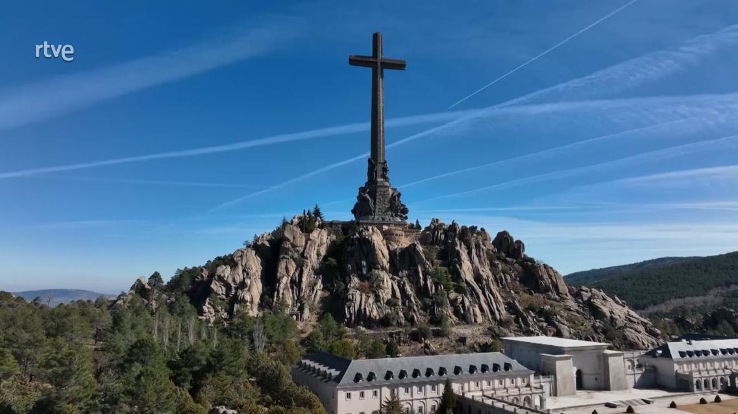
PD CONFERENCE 2026 - PRAGUE
The Valley of
Cuelgamuros
Jaime del Rey
State Secretariat for Democratic Memory
Ministry of Territorial Policy and Democratic Memory
Valley of Cuelgamuros · aerial view
Image: RTVE

Slide 2

THE AUTHOR · THE NARRATIVE
Why is the Valley so important?
An emblematic monument: Probably the most iconic construction project of Franco's dictatorship.
Monumental scale: Its colossal dimensions make it visible from much of the Sierra de Guadarrama.
Spain's largest Civil War burial site.
A largely unknown and unexplained monument: Even many Spaniards know little about its history.
A controversial legacy: It has never been widely accepted as a genuine symbol of national reconciliation.
5

Slide 3
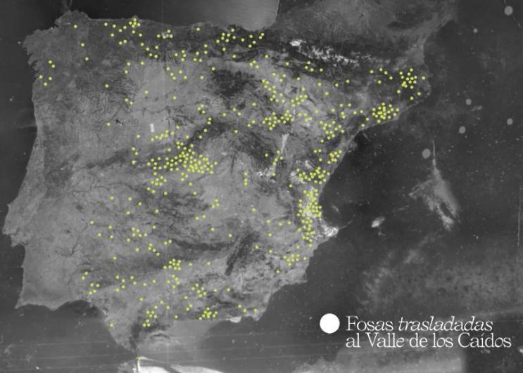
A MASS GRAVE OF WAR VICTIMS
Camilo Alonso Vega (Spain`s Minister of Interior) may 1958, orders civil governors, and through them town councils, to transfer remains to the Valley, "regardless of the side on which they fought".
33,833
people interred in the Valley, two thirds with full names.
500 original burial sites
Data: bodies interred in the Valley by year (1959–1983). Graphic: RTVE, "Fosas trasladadas al Valle de los Caídos".
6

Slide 4
A TRANSFORMATION · 2007–2023
Legal change and historic milestones
2007
Historical Memory Law (Ley 52/2007)
Only those who died in the Civil War may be buried in the Valley.
2019
Franco exhumed
2022
Democratic Memory Law (Ley 20/2022)
24 October: remains moved to Mingorrubio. CSIC studies the crypts the same year.
Art. 54: any remains in a preeminent place are to be relocated.
2023
Primo de Rivera moved
2023
First crypt opened
24 April: exhumed and transferred to San Isidro.
12 June: opening of the first crypt, Santo Sepulcro chapel.
Sources: Ley 52/2007; Experts Commission report, 29 Nov 2011; Ley 20/2022, art. 54.
7

Slide 5
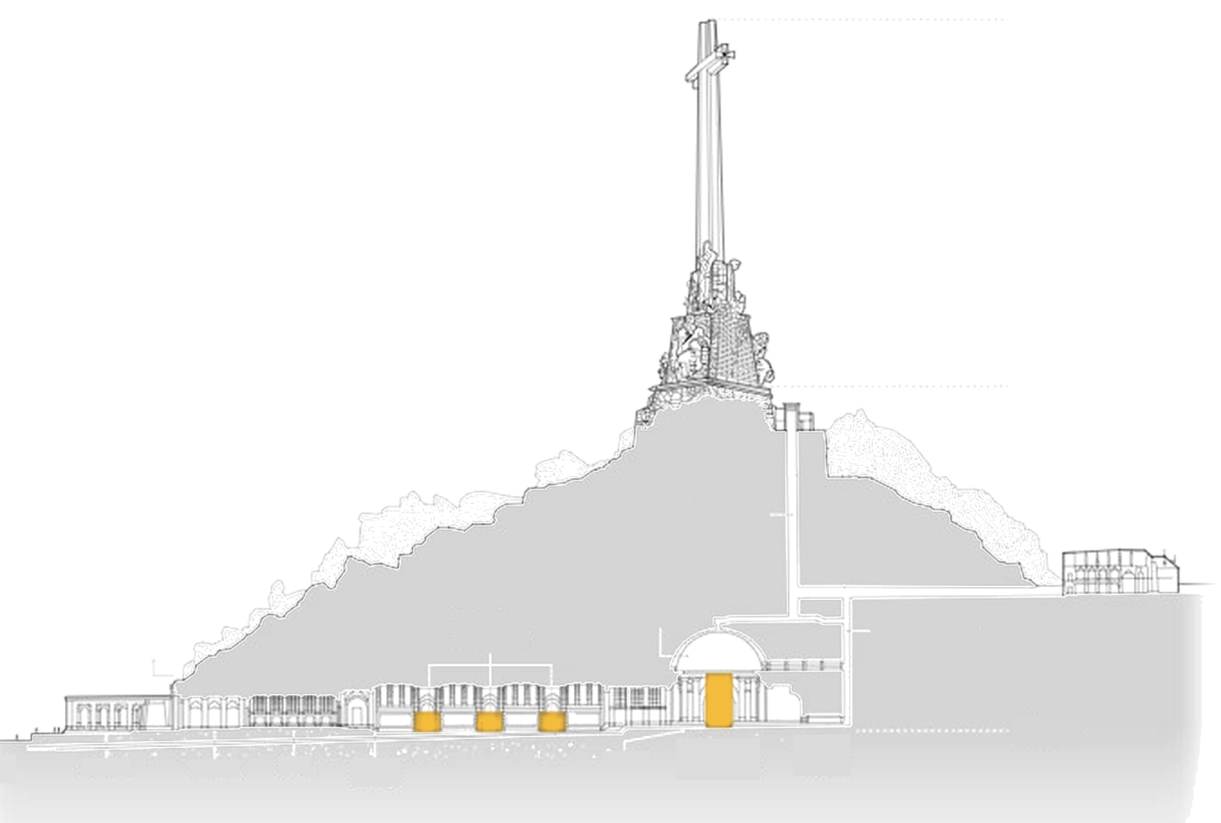
THE SETTING · SECTION
A common grave beneath
the mountain (cross-section)
Chapels where remains are held
Longitudinal
section of
the basilica
Pietà
sculpture
Arcade
Vestibule
Infographic: RTVE / DatosRTVE (design: Hiberus), "Dónde están los 33.800: lo que ocultan las paredes de Cuelgamuros", 25 Sep 2026. Recoloured on white; labels translated into English.
2

Slide 6
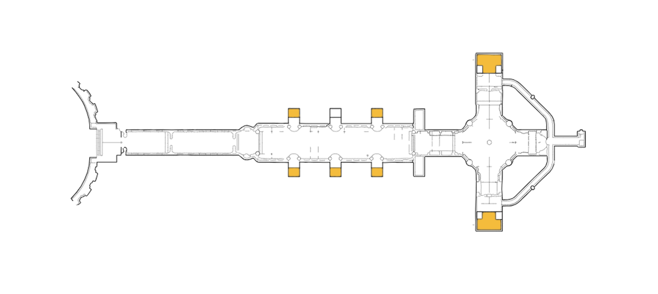
THE BASILICA · FLOOR PLAN
Chapels where remains are held (floor plan)
Yellow: five side chapels of the nave, plus the Blessed Sacrament and Santo Sepulcro chapels.
Blessed Sacrament
Chapel
Virgin of
Africa
Virgin of
Mercy
Virgin of
the Pilar
Chapels where remains are held
Virgin of the
Immaculate
Conception
Virgin of
Carmen
Virgin of
Loreto
Santo Sepulcro
Chapel
Infographic: RTVE / DatosRTVE (design: Hiberus), "Dónde están los 33.800: lo que ocultan las paredes de Cuelgamuros", 25 Sep 2026. Recoloured on white; labels translated into English.
3

Slide 7
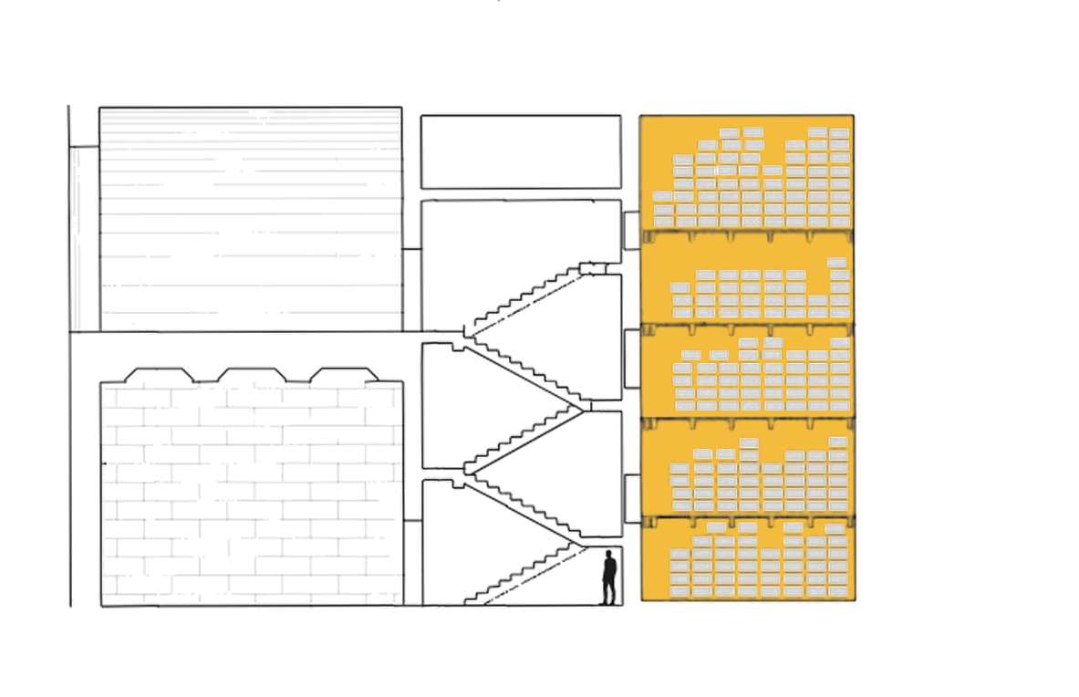
THE SANTO SEPULCRO CHAPEL · COLUMBARIUM
Five levels of niches, more than 18,000 victims
Santo Sepulcro
Chapel
18,391
Columbarium
victims in the five levels (sum of the figures shown in the RTVE graphic).
Level 4
4,755 victims
Level 3
2,223 victims
54%
Level 2
3,293 victims
of the 33,800+ victims moved to the basilica are in the Santo Sepulcro columbarium (RTVE).
Level 1
3,854 victims
Level 0
4,266 victims
Laboratory
Infographic: RTVE / DatosRTVE (design: Hiberus), "Dónde están los 33.800: lo que ocultan las paredes de Cuelgamuros", 25 Sep 2026. Recoloured on white; labels translated into English.
9

Slide 8

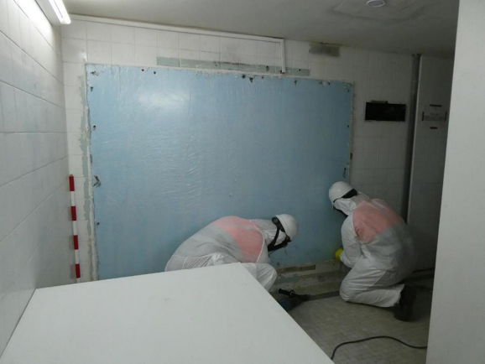
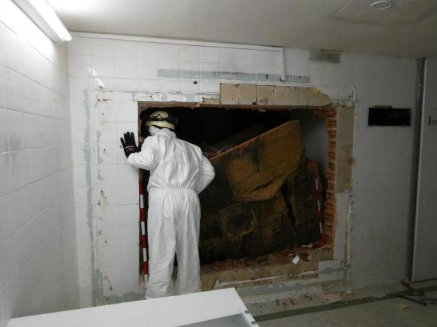
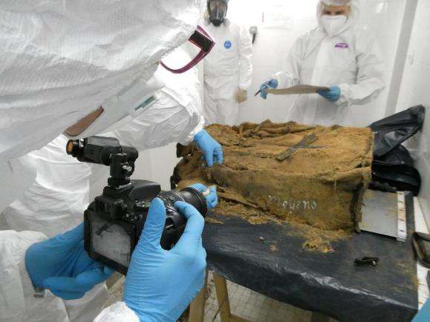
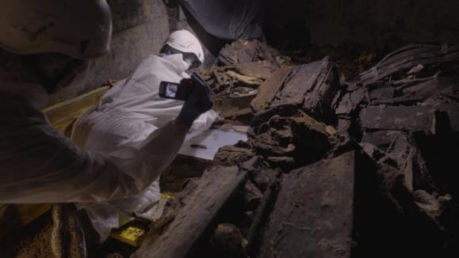
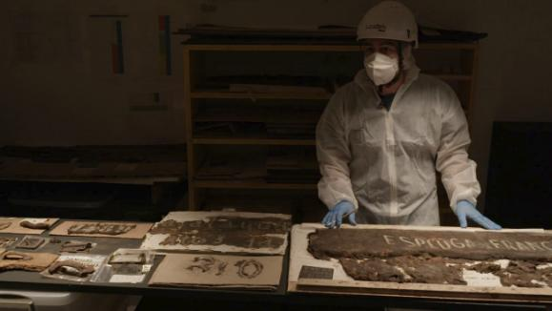
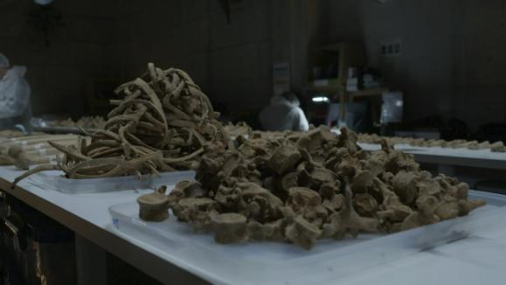
FROM LAW TO PRACTICE
From opening the Sto. Sepulcro crypt to forensic analysis
Top row: Santo Sepulcro chapel, 12 June 2023. Original photo credits to be confirmed.
Bottom row: Documenta RTVE / RTVE. Source: RTVE, 25 Sep 2026 (laboratory infographic).
11
Notes:
Photo sources and credits
Top row: extracted at original embedded resolution from supplied deck, Santo Sepulcro chapel: opening the crypt. Original author credits remain unconfirmed.
Bottom row: three photographs exactly matching the supplied screenshot, extracted without rescaling from the raster linked by RTVE laboratory infographic. Credit: Documenta RTVE / RTVE. No open reuse licence established.
Article: https://www.rtve.es/noticias/20260925/tras-las-paredes-de-cuelgamuros/17241108.shtml
Infographic: https://css2.rtve.es/css/rtve.contenidos/2026/cuelgamuros/laboratorio/laboratorio.desktp.svg
Raster source: https://css2.rtve.es/css/rtve.contenidos/2026/cuelgamuros/laboratorio/laboratorio.desktp.png

Slide 9
RESULTS AND CHALLENGES
Where the process stands
222
411
Families have been granted permission
bodies exhumed (Santo Sepulcro)
304
25
bodies genetically analysed
bodies identified and returned to families
Next challenges
• Launch of the State DNA Bank.
• Mass upload of thousands of DNA profiles from 11 accredited labs.
• Finding more matches.
Thanks: Francisco Ferrándiz (CSIC), Francisco Etxeberría (SEMD). Graphic resources: RTVE. elvalledecuelgamuros.gob.es
13

Slide 10
PD CONFERENCE 2026 - PRAGUE
Thank you !
Jaime del Rey
State Secretariat for Democratic
Ministry of Territorial Policy and Democratic Memory
Notes:
Cover added 4 October 2026. English editorial title summarises the scope of the supplied six-slide deck, not the official title of a congress or ministry publication. No sponsorship/affiliation claim is added.
Logo: official black-and-white asset supplied on the ministry institutional-image page. Original logo kept intact, with original proportions and black-and-white colours; no redraw or recolouring.
Source: https://mptmd.gob.es/portal/politica-territorial/local/coop_econom_local_estado_fondos_europeos/ayudas_catastrofes/imagen_institucional
Asset: https://mptmd.gob.es/portal/politica-territorial/local/coop_econom_local_estado_fondos_europeos/ayudas_catastrofes/imagen_institucional/_jcr_content/root/container/containerSpace/vertical_menu/vertical-menu-container/subtittle_img5/img.coreimg.png/1761836275817/mptmd-gob-bn-lowres.png
Photo: same Priaranza excavation image already included in the source deck; Emilio Silva / RTVE. Source verified 4 October 2026: https://www.rtve.es/noticias/20251021/25-primera-exhumacion-cientifica-dia-emilio-silva-aprendio-tierra-tiene-propia-memoria/16760492.shtml
Photo rendered in warm monochrome to match the deck's muted palette. Composition retained without cropping. Attribution is not a reuse licence. Reuse rights remain unconfirmed; establish permission before public publication.
Existing six slides retained in the full deck, including source notes and provisional census figure. The cover has no page number; existing content numbering 1-6 remains unchanged.

