Slide 1

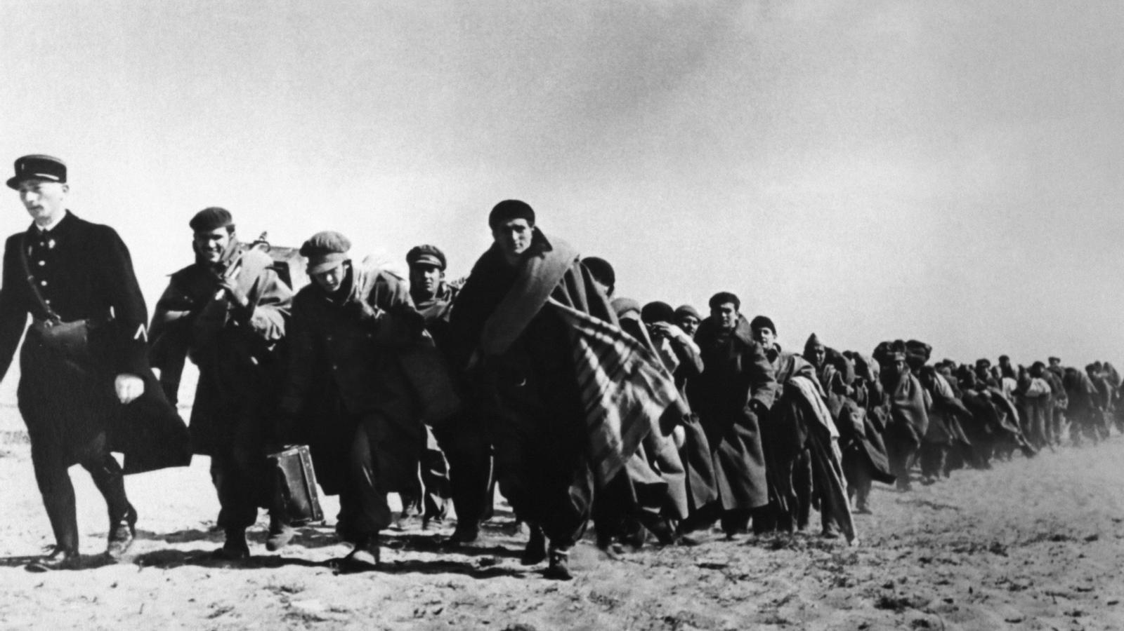
PD CONFERENCE 2026 - PRAGUE
Democratic
memory in Spain
Jaime del Rey
State Secretariat for Democratic Memory
Ministry of Territorial Policy and Democratic Memory
Spanish Republican refugees at the entrance to France, February 1939.
Photo: Auguste Chauvin / Archives départementales des Pyrénées-Orientales / Wikimedia Commons. CC BY-SA 4.0.
Notes:
Cover added 4 October 2026. English editorial title summarises the scope of the supplied six-slide deck, not the official title of a congress or ministry publication. No sponsorship/affiliation claim is added.
Logo: official black-and-white asset supplied on the ministry institutional-image page. Original logo kept intact, with original proportions and black-and-white colours; no redraw or recolouring.
Source: https://mptmd.gob.es/portal/politica-territorial/local/coop_econom_local_estado_fondos_europeos/ayudas_catastrofes/imagen_institucional
Asset: https://mptmd.gob.es/portal/politica-territorial/local/coop_econom_local_estado_fondos_europeos/ayudas_catastrofes/imagen_institucional/_jcr_content/root/container/containerSpace/vertical_menu/vertical-menu-container/subtittle_img5/img.coreimg.png/1761836275817/mptmd-gob-bn-lowres.png
Photo: same Priaranza excavation image already included in the source deck; Emilio Silva / RTVE. Source verified 4 October 2026: https://www.rtve.es/noticias/20251021/25-primera-exhumacion-cientifica-dia-emilio-silva-aprendio-tierra-tiene-propia-memoria/16760492.shtml
Photo rendered in warm monochrome to match the deck's muted palette. Composition retained without cropping. Attribution is not a reuse licence. Reuse rights remain unconfirmed; establish permission before public publication.
Existing six slides retained in the full deck, including source notes and provisional census figure. The cover has no page number; existing content numbering 1-6 remains unchanged.

Slide 2
CONTENTS
Index
1
Introduction to the Civil War
2
Cronology and policies to search for the disappeared victims
3
Map of mass graves
4
Register and census of victims

Slide 3
PART 1 OF 4
1
Introduction to the Civil War

Slide 4
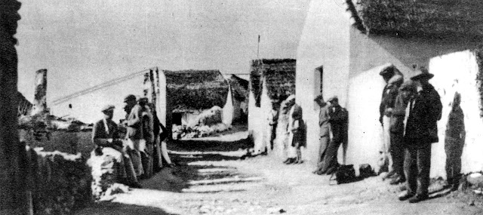
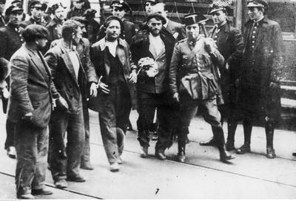
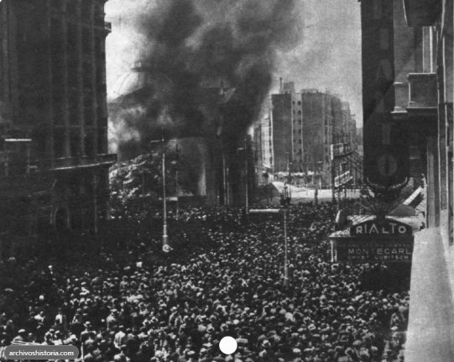
THE CIVIL WAR · CAUSES
Spanish Civil War, the causes…
Casas Viejas, 1933 · Campúa / Crónica
BNE, via S. Gutiérrez Baena
Arrested workers, Asturias, 1934
Illustrated Daily Courier / NAC · Public domain
Burning of the Church of San Francisco Madrid, May 1931. Photo: José María Díaz Casariego / Municipal Newspaper Archive.
Unequal land and development
Reform and social conflict
Religion and polarisation
Republican reforms met opposition from landowners and established powers. Strikes and revolutionary movements suppressed by army. (Asturias prelude).
Rural poverty and low literacy. Industry concentrated in regions such as Catalonia and the Basque Country.
Church links to stablished powers led to strong hostility among progressive politycal parties. Political violence weakened the Republic.
Immediate trigger
The military coup of 18 July 1936 only partly succeeded, dividing the country and opening the way to war.
Sources: Julián Casanova (2012); USHMM · Archive-photo credits on cards; full links in slide notes.
1
Notes:
Historical framing: social inequality and reform conflicts were background conditions, not a deterministic cause. Removed "quasi-feudal", blanket political labels and unsupported assertion that a majority of army officers joined.
History: https://www.cambridge.org/core/books/spanish-republic-and-civil-war/34579D5589717B5C272700D4996B4EBE
https://encyclopedia.ushmm.org/content/en/article/spanish-civil-war
Agrarian context: https://www.lse.ac.uk/Economic-History/Assets/Documents/Seminars/EH/Papers2016-17/Domenech.pdf
Photos:
Casas Viejas, Calle Nueva: https://historiacasasviejas.es/2021/03/casas-viejas-en-la-hemoroteca-digital-2/ (Campúa, archive photograph via BNE historical press; no explicit open licence on this page).
Workers: https://www.ieg-ego.eu/en/mediainfo/asturian-miners-strike-of-1934 (public domain, NAC Poland).
Cardinal: https://commons.wikimedia.org/wiki/File:Cardenal_Pedro_Segura_1936.jpg (CC BY 4.0 as stated on Commons; https://creativecommons.org/licenses/by/4.0/ ; resized). This is a portrait of a church leader, not a photograph of landowners. No landowner image is mislabelled as evidence.

Slide 5
TERRITORIAL CONTROL · 1936–1939
The Spanish Civil War: a changing front
July 1936
October 1937
July 1938
February 1939
Barcelona
Barcelona
Barcelona
Madrid
Madrid
Madrid
Madrid
Barcelona
After the military uprising
The northern front has fallen
Republican territory is divided
After the fall of Catalonia
Republican
control
~500,000
~500,000
Human
toll
Rebel control
lives lost in the war (soldiers, political killings)
refugees to France, Mexico and LATAM, 1939
Approximate estimates · Sources: USHMM; Musée de l’histoire de l’immigration
Maps adapted from Grandiose, NordNordWest & Sting · Wikimedia Commons · CC BY-SA 3.0
2
Notes:
Human toll figures are approximate, not precise casualty counts. ~500,000 lives lost in the conflict (includes combatants and civilians; not all postwar repression). ~500,000 refugees to France in 1939, not the total displaced population.
https://encyclopedia.ushmm.org/content/en/article/spanish-civil-war
https://www.histoire-immigration.fr/en/migration-characteristics-by-country-of-origin/the-retirada-or-post-war-spanish-republican-exile

Slide 6
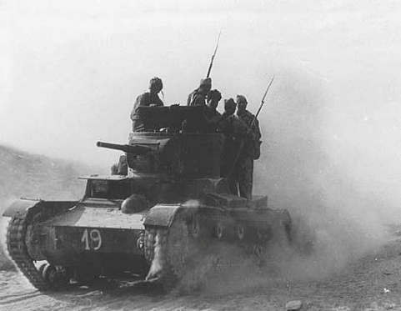
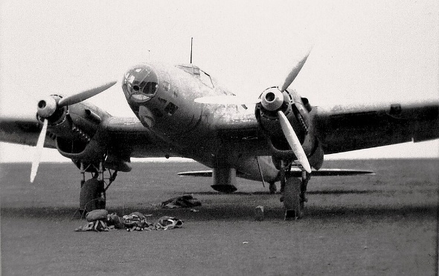
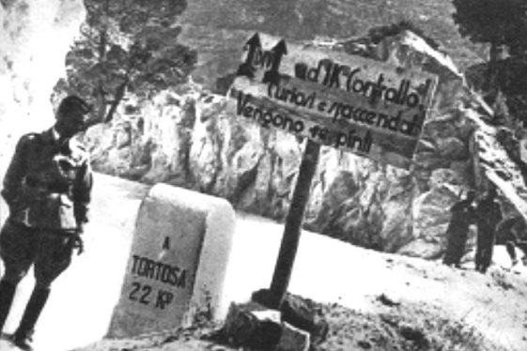
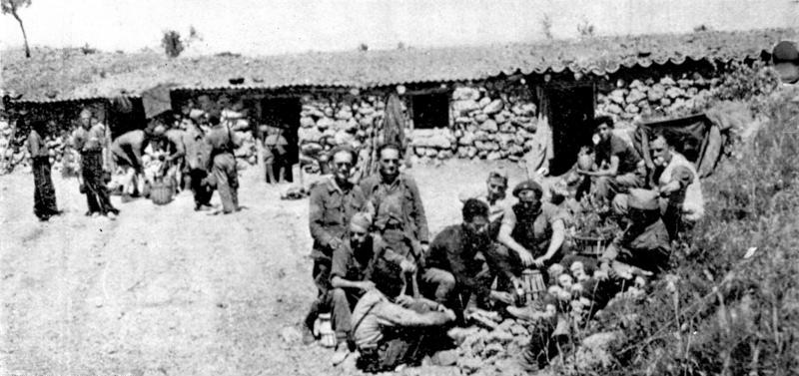
THE CIVIL WAR · FOREIGN INVOLVEMENT
Foreign involvement in the Civil War
REPUBLICAN SIDE
FRANCOIST SIDE
Etkar André Battalion
Bundesarchiv, Bild 183-H28510
CC BY-SA 3.0 DE · resized
Soviet-built T-26, Belchite, 1937
International Brigadiers shown
Unknown / Wikimedia · Public domain
Condor Legion He 111, 1937–38
Herzog family album / Wikimedia
Unknown · Public domain
CTV troops near Tortosa, 1938
Unknown / BNE, via Wikimedia
Public domain
International
Brigades
Soviet Union
Hitler's Germany
Mussolini's Italy
VOLUNTEER FIGHTERS
WEAPONS + SPECIALISTS
REGULAR ARMED FORCES
REGULAR ARMED FORCES
Foreign volunteers
Advisers, pilots
and tank crews
Condor Legion
Air force + army personnel
CTV: regular army
+ Fascist militia
Sources: USHMM; D. Kowalsky, Columbia UP; Museu d'Història de Catalunya · Photo credits on cards; links in notes.
1
Notes:
Foreign involvement in the Spanish Civil War, 1936-1939.
Scope: four selected forms of intervention, not an exhaustive list of foreign involvement.
Historical distinction: the USSR supplied weapons and military advisers and also sent pilots and tank crews who fought. It is inaccurate to say no Soviet troops took part. It did not send an expeditionary land army comparable to Italy's CTV. The CTV combined regular army personnel and Fascist Blackshirt militia. The Condor Legion consisted of German armed-forces personnel.
Facts:
https://encyclopedia.ushmm.org/content/en/article/spanish-civil-war
https://www.gutenberg-e.org/kod01/kod17.html
https://www.mhcat.cat/esmhc/exposiciones/exposiciones_realizadas/fu_la_spagna
https://museomitag.it/wp-content/uploads/2023/03/Annali_30-art_01f-studi-e-ricerche-Perez.pdf
Photos (all resized, no people identified as Soviet crews):
brigade: https://commons.wikimedia.org/wiki/File:Bundesarchiv_Bild_183-H28510%2C_Spanien%2C_Gefechtsstand_des_Etkar_Andr%C3%A9_Bataillons.jpg
tank: https://commons.wikimedia.org/wiki/File:%D0%98%D1%81%D0%BF%D0%B0%D0%BD%D1%81%D0%BA%D0%B0%D1%8F_11_%D0%B8%D0%BD%D1%82%D0%B5%D1%80%D0%B1%D1%80%D0%B8%D0%B3%D0%B0%D0%B4%D0%B0_%D0%B2_%D0%B1%D0%BE%D1%8E_%D0%BF%D0%BE%D0%B4_%D0%91%D0%B5%D0%BB%D1%8C%D1%87%D0%B8%D1%82%D0%B5._1937-edit.jpg
condor: https://commons.wikimedia.org/wiki/File:He_111_B-1_o._B-2%2C_Spanien%2C_1937-38_(1).jpg
italy: https://commons.wikimedia.org/wiki/File:CTV_troops_near_Tortosa.jpg
Bundesarchiv image license: https://creativecommons.org/licenses/by-sa/3.0/de/deed.en . The other three files are marked public domain by Wikimedia Commons; underlying archival metadata and anonymous-author status govern reuse. The Soviet card photograph shows International Brigadiers on a Soviet-built tank, not identifiable Soviet servicemen.

Slide 7
PART 2 OF 4
2
Cronology and policies to search for the disappeared victims

Slide 8
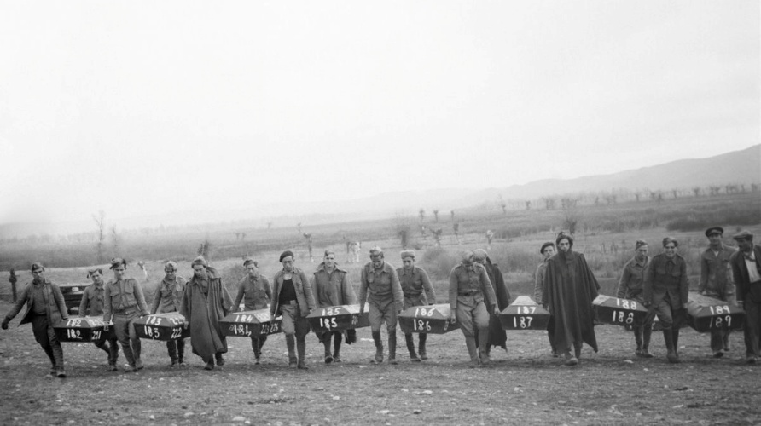
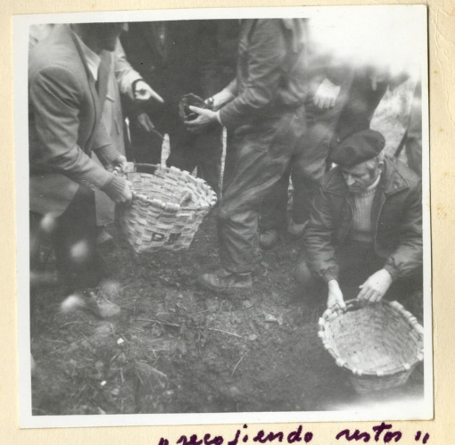
CHRONOLOGY · 1936–1982
From war and dictatorship to the transition
Civil War
Franco dictatorship
Transition to democracy
1936–1939
1939–1975
1975–1982
1939
1975
1978
1978–1980
1981
Reburial at
Paracuellos
Franco's death
Constitution
Family-led exhumations
23-F coup attempt
Schematic timeline · not to scale
20 November
Navarre, Extremadura…
23 February
The regime honoured its own dead, excluding Republican victims.
Sartaguda families at Ollacarizqueta.
No systematic forensic protocols.
Photo: Hermes Pato / EFE, via elDiario.es
Photo: Instituto Navarro de la Memoria · CC BY-NC 4.0
Sources: elDiario.es; Instituto Navarro de la Memoria; Aguilar (2018); RTVE; Congreso de los Diputados. Links in notes.
3
Notes:
Chronology slide revised 15 October 2026. Dates are displayed schematically, not to scale. Transition 1975–1982 is a conventional periodisation, not a single legal end date.
1939: exhumations in Torrejón de Ardoz and transfer of coffins to Paracuellos. Hermes Pato/EFE photograph, as credited by elDiario.es. Not openly licensed; presentation use accepted by the user, with visible credit. Rights clearance may be required for external publication.
https://www.eldiario.es/sociedad/exhumados-dios-espana-cuerpos-si-recuperados-homenajeados-guerra-civil_1_11665752.html
1975: Franco died on 20 November.
https://www.rtve.es/rtve/20180221/muerte-franco-proclamacion-del-rey/1681862.shtml
1978 Constitution:
https://blog.congreso.es/6-de-diciembre-del-78/
1978–1980: main wave of early exhumations in Navarre. Paloma Aguilar (2018). Photo shows Sartaguda families at Ollacarizqueta; its exact date is not independently established. Government of Navarre records family exhumations at this site in 1979. This illustrates the wider period, not a claim that the photo dates to every year.
https://www.cepc.gob.es/sites/default/files/2023-04/38309hyp3911palomaaguilar.pdf
https://www.navarra.es/es/noticias/2019/09/30/localizados-en-ollacarizqueta-los-restos-de-16-victimas-del-golpe-militar-de-1936
https://exhumacionestempranas.navarra.es/exhumaciones_transici%C3%B3n#ww1_45
https://exhumacionestempranas.navarra.es/project
https://creativecommons.org/licenses/by-nc/4.0/
Photo: Instituto Navarro de la Memoria, CC BY-NC 4.0. Non-commercial reuse only.
1981: 23-F coup attempt. No causal claim about stopping exhumations is made.
https://www.congreso.es/public_oficiales/L1/CONG/DS/PL/PL_146.PDF

Slide 9
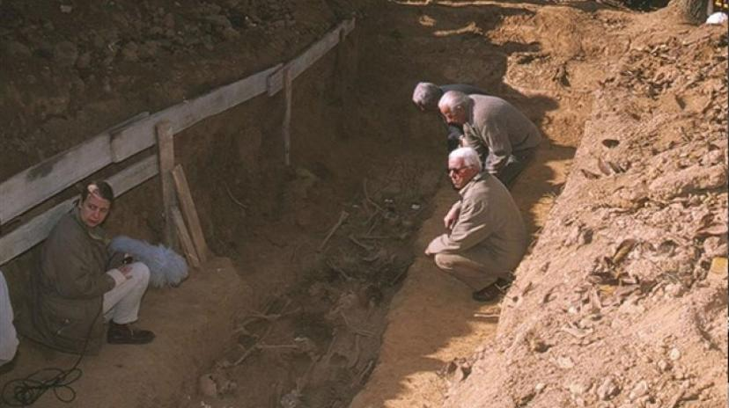
CHRONOLOGY · 2000–2026
The scientific turn and renewed public policy
Scientific turn
Historical Memory Law
Renewed state policy
2000–2006
2007–2018
2019–2026
2000
2007
2019
2022
2026
Priaranza
del Bierzo
Historical
Memory Law
Renewed
policy impetus
Democratic
Memory Law
Implementing
the 2022 law
First scientific exhumation
Law 52/2007
Sánchez governments
Law 20/2022
Timeline endpoint
Schematic timeline · not to scale
Priaranza del Bierzo: thirteen victims exhumed; ARMH founded.
2007: the state supports searches led by families.
2022: the state takes responsibility for search and identification.
Photo: Emilio Silva / RTVE · October 2000 excavation
Sources: ARMH; RTVE; BOE, Laws 52/2007 and 20/2022; La Moncloa, exhumation plan (2024)
4
Notes:
Priaranza scientific-exhumation landmark in October 2000: https://memoriahistorica.org.es/los-13-de-priaranza/
https://www.rtve.es/noticias/20251021/25-primera-exhumacion-cientifica-dia-emilio-silva-aprendio-tierra-tiene-propia-memoria/16760492.shtml
"First" is restricted to the modern scientific cycle of family-led Francoist-victim recovery, not every exhumation in Spanish history. Different accounts give 21 October (start) and 28 October (recovery), so slide says October.
Photo verified: https://img2.rtve.es/n/16760492?w=1600, caption Exhumación de la fosa de Priaranza, credited Emilio Silva. REUSE RIGHTS NOT CONFIRMED. Do not publish until permission is established.
2007 law https://www.boe.es/buscar/act.php?id=BOE-A-2007-22296
2022 law https://www.boe.es/eli/es/l/2022/10/19/20/
Renewed exhumation policy https://www.lamoncloa.gob.es/serviciosdeprensa/notasprensa/politica-territorial-memoria-democratica/paginas/2024/200324-exhumaciones-guerra-civil.aspx. 2019 is user-selected period marker; plans started 2020. 2026 is presentation endpoint, not an asserted completed event.
Rebuilt Oct 15 as a schematic horizontal timeline (not to scale). Era bands are editorial groupings. 2019 is a period marker: Sánchez governments since 2018; state exhumation grants verified for 2021 (114 projects, MPR 4 Mar 2021 https://www.mpr.gob.es/prencom/notas/paginas/2021/040321-ayudasproyectos.aspx); four-year exhumation plan: https://www.lamoncloa.gob.es/serviciosdeprensa/notasprensa/politica-territorial-memoria-democratica/paginas/2024/200324-exhumaciones-guerra-civil.aspx. Law 20/2022 of 19 Oct 2022, art. 16: state responsibility for search. Priaranza: thirteen bodies exhumed Oct 2000, origin of ARMH (https://arquitecturaymemoria.es/cronologia-de-acciones-memoriales-en-la-fosa-de-priaranza-del-bierzo/).

Slide 10
PUBLIC POLICY · FUNDING ROUTES
SEMD Funding Supports Missing Persons Search Projects (2019-26)
State Secretariat for Democratic Memory
SEMD
Autonomous
communities
Municipalities
Universities
and associations
Direct execution
Territorial Council
funding
FEMP funding and
direct grants
Competitive grants
Contracts initiated
and controlled by SEMD
Funding routes supplied by Jaime del Rey · Schematic flow, not an organisational chart.
5
Notes:
Author-specified routes, supplied 14 October 2026. No amounts or intervention counts on this slide. FEMP = Spanish Federation of Municipalities and Provinces. The FEMP route and direct municipal grants share a municipal destination. Direct-execution contracts are initiated and controlled by SEMD. Native editable boxes/connectors.

Slide 11
PUBLIC POLICY · TERRITORIAL REACH
SEMD- Victims Search Projects Across Spain
Cumulative amount by locality · 2019-2026
Funding route | Amount (€) | Interventions
Direct execution by SEMD | 825,699.99 | 20
Competitive grants (Univ&Associations) | 305,943.07 | 16
Direct municipal grants | 6,372,668.16 | 49
FEMP → municipalities | 6,144,473.62 | 308
Territorial Council → regions | 11,932,848.78 | 518
TOTAL | 25,581,633.62 | 911
462 localities · 845 incorporated source rows
Bubble area = amount; minimum visible size for small amounts.
€10,000
€50,000
€200,000
Interventions are not distinct localities; the two totals differ in scope.
Map: Obra derivada de BDLJE CC-BY 4.0 ign.es · Portugal: Natural Earth · Table: Jaime del Rey, supplied 14 Oct 2026.
6
Notes:
Map copied as native editable freeforms and circles from the supplied Pytos España deck; positions and bubble sizes scaled uniformly. Original map: 462 localities, 845 incorporated rows, all spreadsheet exercises. No new period inferred. Funding table transcribed from author-provided data of 14 Oct 2026; exact sum verified: €25,581,633.62, 911 interventions. Map and table counts have different scopes and must not be treated as interchangeable. No table reporting period was supplied, so none is invented. Competitive grants = subvenciones en concurrencia competitiva. FEMP = Spanish Federation of Municipalities and Provinces.

Slide 12
PART 3 OF 4
3
Map of mass graves

Slide 13
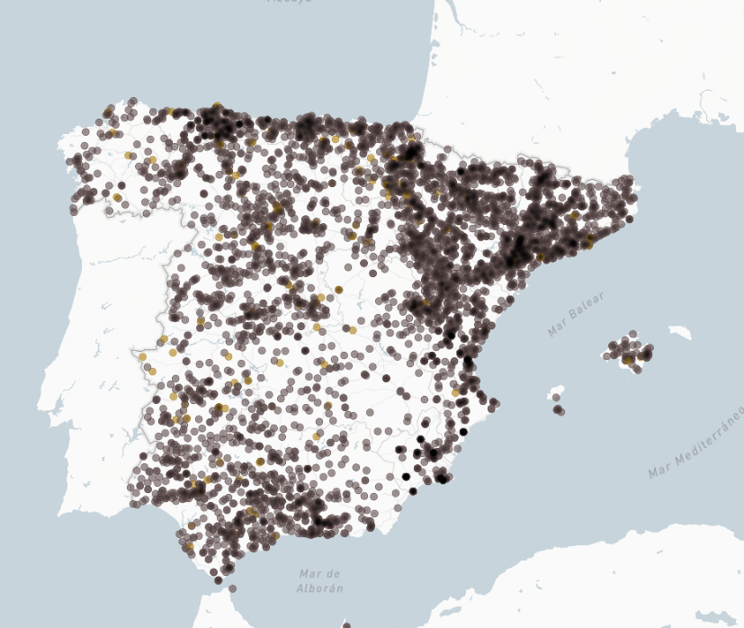
STATE MAP OF FOSAS
Where to look for the victims? State Map of Mass graves
5,932
62,530
Mass graves on the State Map
victims named and linked to those mass graves
Legal basis: Article 17, Law 20/2022
The State Administration must produce an integrated map of the location of missing persons covering all of Spain, fed by data from the competent administrations. The cartography is public and updated periodically.
A living tool
Built by the Ministry with the Autonomous Communities, universities, associations and foundations. Updated gradually; the audiovisual version was made with RTVE.
Image: “El país de las 6.000 fosas”, RTVE.es with the Ministerio de Política Territorial y Memoria Democrática (screenshot, 4 Oct 2026).
Sources: Ministerio de Política Territorial y Memoria Democrática, Mapa estatal de fosas (read 4 Oct 2026); BOE, Law 20/2022, art. 17. Victim total counted from the map’s public records.
7
Notes:
MAPA DE FOSAS - sources and caveats
Figures read live on 4 Oct 2026 from the Ministry's State Map (embedded viewer at https://mptmd.gob.es/portal/memoria-democratica/mapa-de-fosas/buscador-mapa-fosas):
- 5,932 fosas: the total the map itself displays ("5932 fosas en total").
- 62,530 victims: NOT shown as a total on the Ministry page. Counted from the map's public records: distinct victim IDs linked to fosas ("difuntos documentados") across 3,609 fosas. Last record modification in the dataset: 25 Sep 2026.
- For reference: summing the "number buried" field gives about 145,000 persons reported buried (filled for 4,493 fosas). This is an estimate field, not documented named victims, so it is not used on the slide.
- RTVE's own map reported about 6,000 fosas (5,932 and 6,252 on different loads on 4 Oct 2026) and, in its methodology, a census of about 67,500 people with more than 40,000 linked to a fosa (as of Oct 2025).
Update the two numbers before presenting if the map changes.
Law: Ley 20/2022, de 19 de octubre, de Memoria Democratica, art. 17 "Mapa integrado de localizacion de personas desaparecidas". Verified in the BOE consolidated text: https://www.boe.es/eli/es/l/2022/10/19/20/ and on the Ministry page https://www.mpr.gob.es/memoriademocratica/mapa-de-fosas/paginas/index.aspx
Image: screenshot of the RTVE project "El pais de las 6.000 fosas" (https://www.rtve.es/noticias/fosas-guerra-civil-franquismo/mapa/), a joint initiative of the Ministry and RTVE (Ministry news item of 12 Nov 2025: https://mptmd.gob.es/portal/prensa/noticias/2025/Noviembre/20251112). Credit is shown on the slide; attribution is not a reuse licence, ask RTVE/Ministry if the deck is published.

Slide 14
PART 4 OF 4
4
Register and census of victims

Slide 15
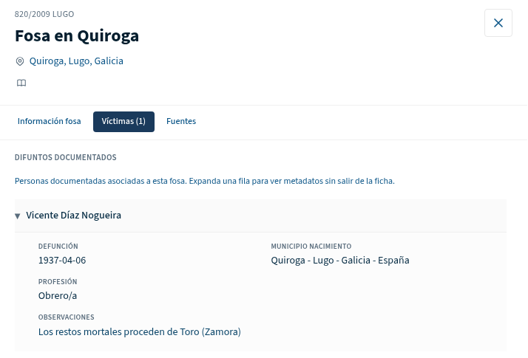
STATE REGISTER AND CENSUS OF VICTIMS
State Register and Census of Victims (restore dignity & simbolic rep)
Established by Article 9, Law 20/2022
The ministry for democratic memory keeps a register of victims, fed by archives, administrations, families, memory associations and university research groups. From it, it draws up a public census of all victims of the War and the Dictatorship.
Agreement with Santiago de Compostela University (USC)
Signed 16 February 2025 and published in the BOE on 5 March 2025. Runs February 2025 to February 2027 (project Cenomi). It covers non-combatant victims who died in 1936-1939.
Where USC looks
Image: example of a victim record (ficha), Mapa estatal de fosas, Ministerio de Política Territorial y Memoria Democrática (screenshot, 4 Oct 2026).
Especially civil registry records
and the military archives of the Ministry of Defence.
500,000*
victims in the census (placeholder, to be updated)
Sources: BOE, Law 20/2022, art. 9; BOE no. 55, 5 Mar 2025 (convenio MPTMD-USC Histagra-CISPAC); Ministerio de Política Territorial y Memoria Democrática. *Placeholder figure, to be updated.
8
Notes:
REGISTRO Y CENSO ESTATAL DE VICTIMAS - sources and caveats
*** PLACEHOLDER: 500,000 victims is a placeholder (per Jaime voice note as relayed by the assistant), NOT a verified number. Update it before presenting (also remove the asterisk note in the slide footer). For reference, RTVE's project methodology (Oct 2025) described the Secretaria de Estado census as including about 67,500 people, of which more than 40,000 were linked to a fosa: https://www.rtve.es/noticias/fosas-guerra-civil-franquismo/mapa/ ***
Law: Ley 20/2022, art. 9 "Registro y Censo Estatal de Victimas" (apartados 1-3): register of victims kept by the ministry competent in democratic memory; public census of all victims of the War and the Dictatorship built from it. BOE: https://www.boe.es/eli/es/l/2022/10/19/20/
Agreement: Convenio between the AGE (Ministerio de Politica Territorial y Memoria Democratica) and the Universidade de Santiago de Compostela (grupo Histagra-CISPAC) for the Censo Estatal de Victimas. Signed 16 Feb 2025; published by Resolucion of 24 Feb 2025, BOE no. 55 of 5 Mar 2025: https://www.boe.es/diario_boe/txt.php?id=BOE-A-2025-4390 . Histagra project page gives 17/02/2025 to 17/02/2027 and principal investigator Lourenzo Fernandez Prieto: https://histagra.usc.es/es/investigacion/585/elaboracion-del-censo-estatal-de-victimas . Ministry page (project Cenomi): https://mptmd.gob.es/portal/memoria-democratica/registro-y-censo-estatal-de-victimas
Scope in the convenio: victims with a death outcome, excluding combatants, in 1936-1939; data collected from civil registries, military archives and other censuses. One work block uses the series of judicial files of summary proceedings (procedimientos sumarisimos) held by the Ministry of Defence.
Image: screenshot of a victim record from the Ministry's State Map (public database of documented victims linked to fosas), shown as a typical ficha. It is not a scan of an original archive document and is not an image of the census itself.

Slide 16
PD CONFERENCE 2026 - PRAGUE
Thank you !
Jaime del Rey
State Secretariat for Democratic
Ministry of Territorial Policy and Democratic Memory
Notes:
Cover added 4 October 2026. English editorial title summarises the scope of the supplied six-slide deck, not the official title of a congress or ministry publication. No sponsorship/affiliation claim is added.
Logo: official black-and-white asset supplied on the ministry institutional-image page. Original logo kept intact, with original proportions and black-and-white colours; no redraw or recolouring.
Source: https://mptmd.gob.es/portal/politica-territorial/local/coop_econom_local_estado_fondos_europeos/ayudas_catastrofes/imagen_institucional
Asset: https://mptmd.gob.es/portal/politica-territorial/local/coop_econom_local_estado_fondos_europeos/ayudas_catastrofes/imagen_institucional/_jcr_content/root/container/containerSpace/vertical_menu/vertical-menu-container/subtittle_img5/img.coreimg.png/1761836275817/mptmd-gob-bn-lowres.png
Photo: same Priaranza excavation image already included in the source deck; Emilio Silva / RTVE. Source verified 4 October 2026: https://www.rtve.es/noticias/20251021/25-primera-exhumacion-cientifica-dia-emilio-silva-aprendio-tierra-tiene-propia-memoria/16760492.shtml
Photo rendered in warm monochrome to match the deck's muted palette. Composition retained without cropping. Attribution is not a reuse licence. Reuse rights remain unconfirmed; establish permission before public publication.
Existing six slides retained in the full deck, including source notes and provisional census figure. The cover has no page number; existing content numbering 1-6 remains unchanged.

